Slide 1
Peel Region
December 2025

Slide 2
Disclaimer
This presentation, together with the accompanying slides and following discussion, contains forward-looking information, forecasts, projections, goals, and strategies (referred to as “forward-looking information”) regarding revenues, funding, expenses, financial condition, and operational results. This document also contains forward-looking statements that may entail risks and uncertainties. This forward-looking information reflects the Region of Peel’s expectations or beliefs about future events and includes known and unknown risks and uncertainties that could cause actual results, performance, or events to differ significantly from those expressed or implied in these statements. Factors that may cause actual future results to differ from those forecasted include, but are not limited to, competition, the economic environment, the business environment, and the Region of Peel’s ability to achieve its strategic business objectives. Consequently, these forward-looking statements must in no way be interpreted as guarantees or assurances from the Region of Peel regarding its future results. This material is intended solely for informational purposes.

Slide 3
Contents
Overview 4
Economic Highlights 9
Financial Overview 13
Debt Financing 20
Contact Details 26

Slide 4
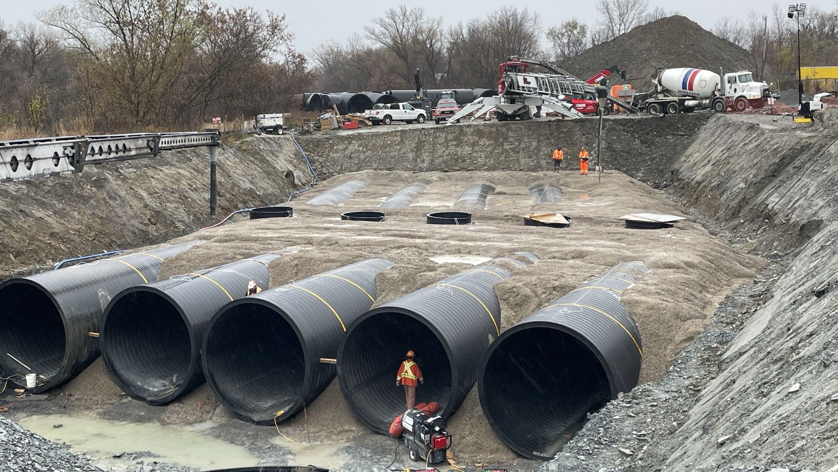
Overview

Slide 5
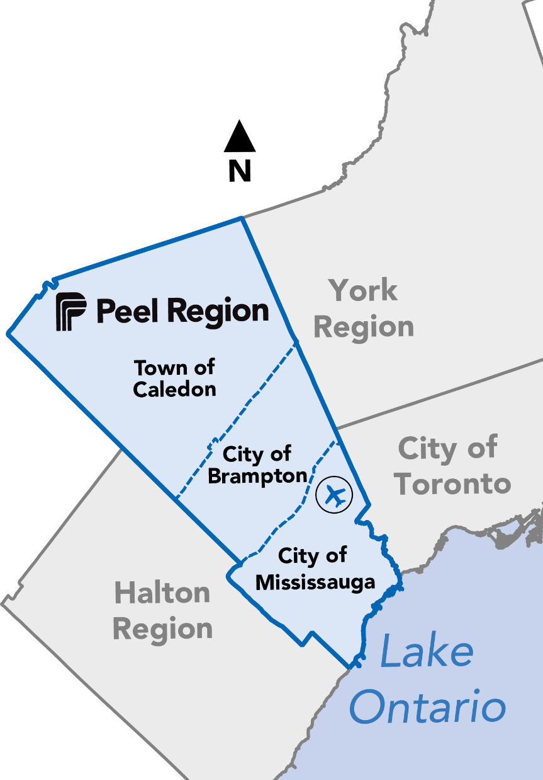

Who We Are
Vision: Community for Life
Mission: Working with you to create a healthy, safe, and connected community

Slide 6












Peel At A Glance
$3.9 billion Annual Operating Budget and $2.3 billion Annual Capital Budget
Population of 1.6 million, larger than 6 of Canada’s provinces
AAA/Aaa Credit Rating for 30 consecutive years
2nd largest water and wastewater system in Ontario and 4th largest in Canada
3rd largest community housing provider in Ontario
2.3% GDP forecast (annual average GDP growth 2025-2029)
$1.8 billion worth in goods travel to, from or through Peel everyday
2nd largest police service in Ontario and 3rd largest in Canada
2nd largest waste management program in Ontario and 4th largest in Canada
2nd largest public health and paramedic services in Ontario
35% lower utility rates than other GTA municipalities
927,400 persons in the labour force

Slide 7
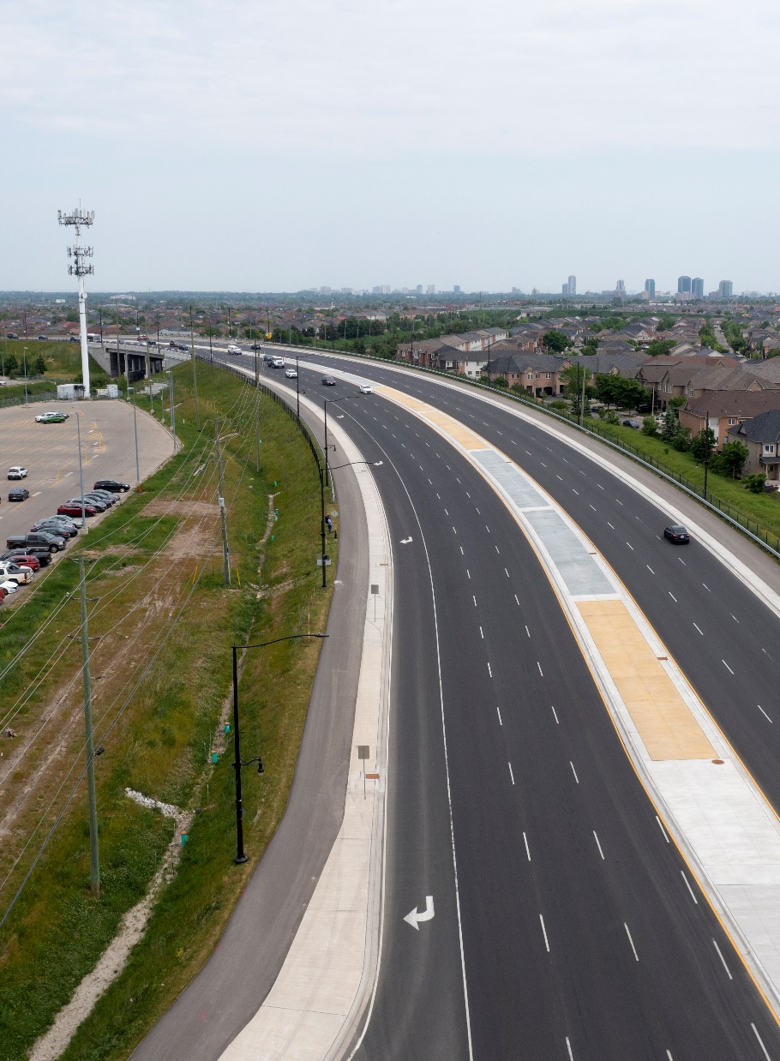
Key Services
Peel delivers the infrastructure necessary to meet the needs of a growing community!
Water Supply
Wastewater
Waste Management
Transportation
Public Health
Police Services
Housing Support
Child Care

Slide 8

Serving Our Community
Over 2,100
New Units/Beds with the majority from Peel’s Community Housing Development Program
$51
billion asset value
Service to more than
1.6
million
people in Peel
$156
million asked in 2025 Budget to enhance
community safety
566 million litres
Average water produced per day
4,789 km
watermains
31.4%
reduction in GHG from 2010 levels

Slide 9
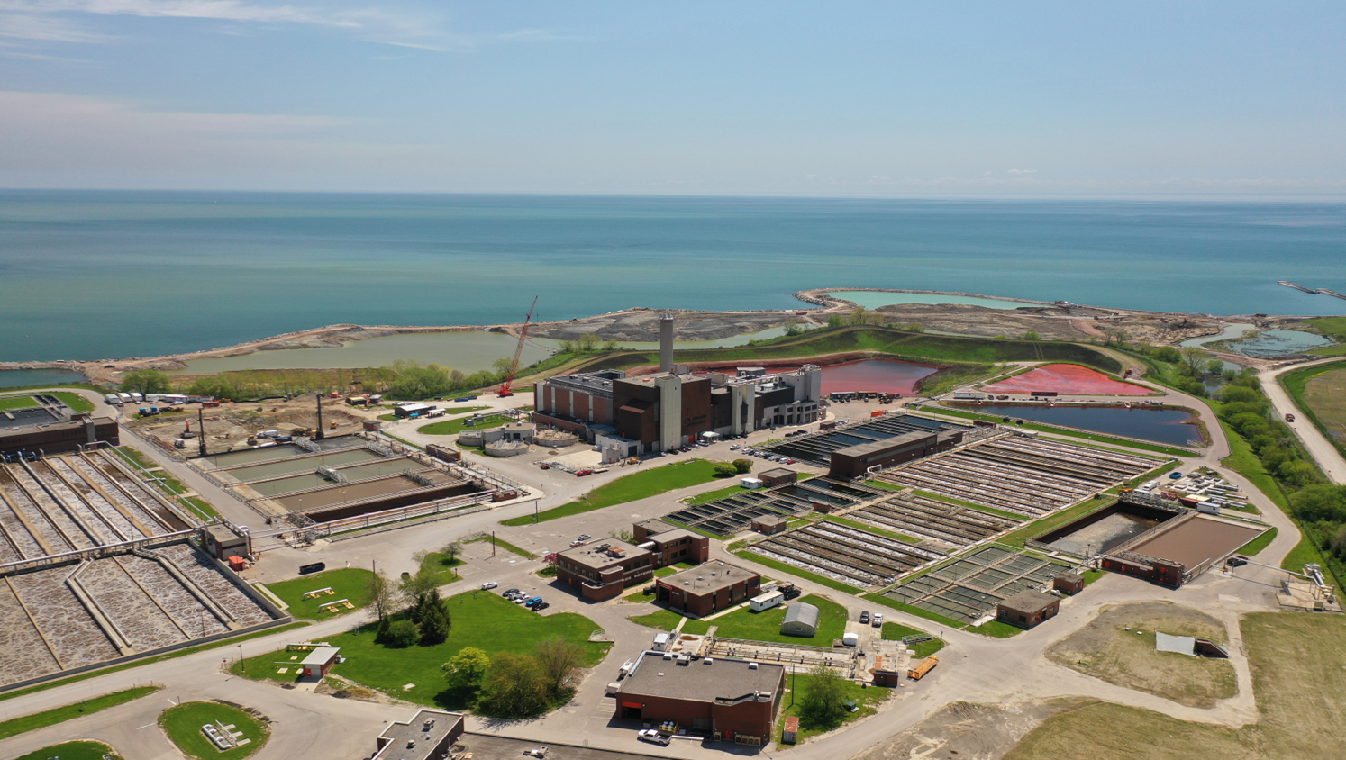
Economic Highlights

Slide 10

Rapid Population Growth
2051
2.50
million
51% increase
2024
1.66
million
51% increase
2003
1.10
million
Young population¹
69%
working age
15 to 64, second highest ratio in the GTA
39 years
average age
Youngest in GTA
Statistics Canada, 2021 Census

Slide 11
Strong and Diverse Business Sector
Distribution of business sectors (2023)
6% annual
Business growth

Slide 12
Stable Housing Sector
Building permits
Housing starts
In billions of dollars
In units
The total value of building permits issued in Peel in 2024 was
$5 billion
increase of 58 per cent relative to 2020.
In 2024, Peel’s annual housing starts were 17 per cent higher than in 2020 at
5,348 units

Slide 13
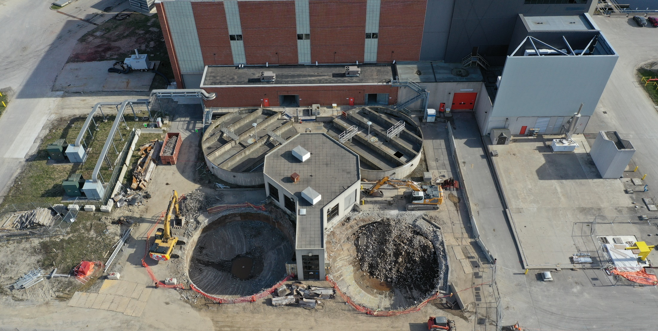
Financial Overview

Slide 14
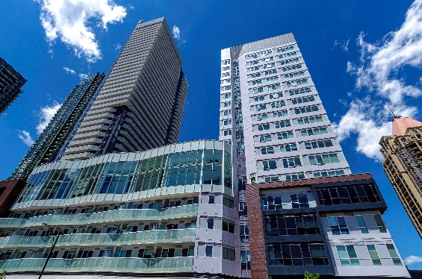

2025 Budget Highlights
$6.2
billion
Invested in services that advance and support Council’s strategic priorities and longer-term outcomes
$2.3
billion
Capital Investments
$3.9
billion
Operating Investments

Slide 15
2025 Operating Budget
Where Your 2025 Tax Dollars Will Be Spent

Slide 16
2025 Operating Budget
Revenue

Slide 17
10 Year Capital Plan
Regionally Controlled Tax | $5,158 million | 22%
Police Services | $965 million | 4%
Utility Rate Supported | $17,339 million | 74%
Capital Plan Funding¹
63% Development charges²
35% Capital Reserves
1% Debt
1% External funding
¹Based on 2025-2034 Capital Plan
²Debt will be used to manage timing mismatch between expenditures and collections

Slide 18
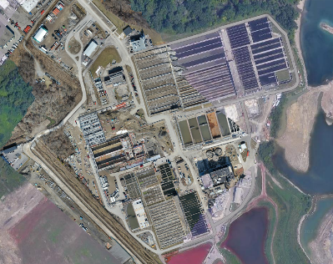
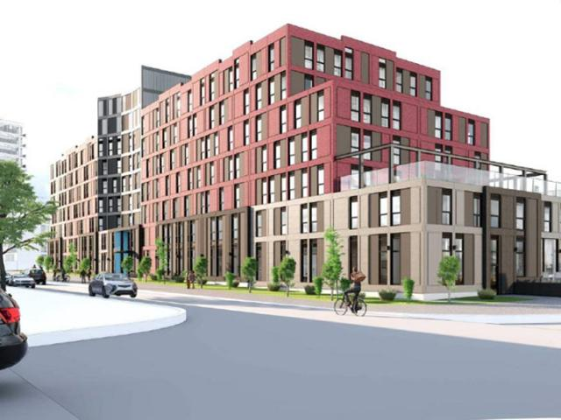
10 Year Capital Plan Highlights
$13.2 billion
New growth- related water and wastewater infrastructure
$1.8 billion
Transportation, road construction, intersection improvements
$0.9 billion
Police Services & Community Safety
$1.0 billion
Community housing development and repair

Slide 19



Financial Strengths
Credit Ratings
Key Financial Metrics (C$ millions)
 | 2022 | 2023 | 2024
Revenue | 3,346 | 3,475 | 3,951
Expenses | 2,763 | 3,128 | 3,471
Annual Surplus | 584 | 347 | 480
Total Financial Assets | 3,881 | 3,830 | 4,104
Reserves & Reserve Funds | 2,630 | 2,770 | 2,868
Net Long-Term Debt | 1,269 | 1,186 | 1,440
Aaa (Stable) since 2011
“The Region maintains excellent reserve balances including long-term investments, which provide significant coverage of debt and expenses.”
AAA (Stable) since 2001
Exceptional Liquidity
“…expanding tax base, strong operating surpluses, robust financial management, and exceptional liquidity will continue to underpin Peel’s credit profile.”
C$3.8 billion in investments
Highly liquid portfolio with strong credit quality

Slide 20


Financial Strengths
Low interest burden provides financial flexibility
3.1% interest/operating revenue
Modest debt levels
3.1%
70%
Debt to Operating Revenue
Large Annual Operating Surpluses
>$500 million, 5-year average
>$500
million
Peel’s results reflect a strong, transparent financial management and governance framework that delivers consistent performance.

Slide 21
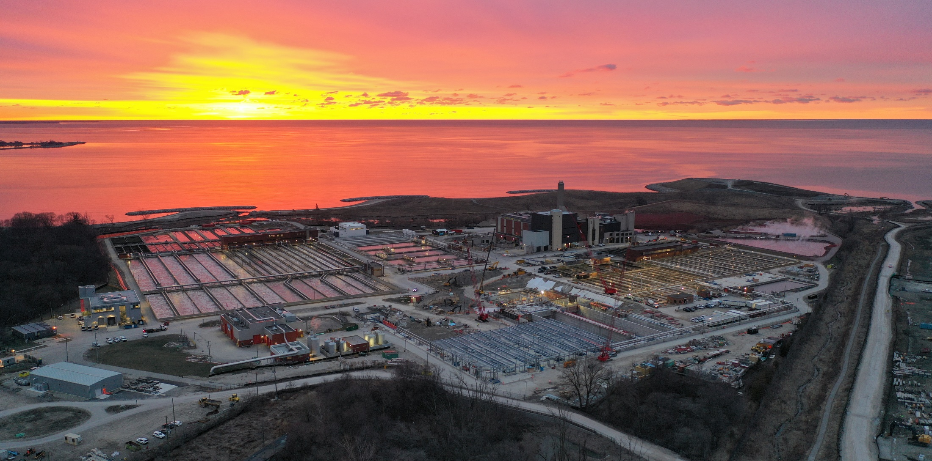
Debt Financing

Slide 22
Historical Debt Issuance
$3.4
billion
Issued in the last 15 years
Source: Region of Peel
All figures in $millions unless otherwise stated
Notes:
Peel has historically been a regular issuer in the debt capital markets through a combination of serial and bullet debentures, issuing approximately $3.0 billion in debentures since 2010.
It is worth mentioning that the Region was absent from debt capital markets during 2023 and 2024 as a result of legislative uncertainty. Given the legislative backdrop at the time and to ensure the continued implementation of the Region’s and local municipalities’ critical capital requirements, the Region was able to work closely with the Province and through the Ontario Financing Authority (OFA) to secure $450 million in debenture financing to support the Region’s and local municipalities’ financing requirements for 2023 and 2024.
Of the $450 million, approximately $345 million supported the Region’s needs, $90 million was raised for Mississauga, and $14.7 million for Caledon
In March of 2025, the Region returned to capital markets with an extremely successful $300 million 10-year debenture that was met with strong investor demand with ~1.5x oversubscription.

Slide 23
Debt Maturity Profile
~17 years
Weighted average term to maturity
Source: Bloomberg & Region of Peel (November 2025)
All figures in $millions unless otherwise stated

Slide 24

Borrowing Strategy
2025 borrowing program highlights
2026 requirements and plan
$600 million capital markets issuance
Successfully completed $300mm 10-year offering in April and $300mm 30-year offering in October this year
Strong investor demand across both transactions, with several new investors
10-year issuance priced at a spread of +11.5bps vs. ONT
30-year issuance priced at a spread of +19bps vs. ONT
>$500 million
Continued focus on liquid issuances in key terms (e.g. 10s, 20s, 30s)
Utilize re-openings where appropriate to build-up benchmark bonds

Slide 25
Investor Protections
Municipal Debentures Rank Pari Passu
s.408(7)
Annual Budgeting Requirements
(Debt Provision and No Operating Deficits)
s.289 and s.290
Limitations on Use of Proceeds
s.413(1) and s.408(2.1)
Debenture By-Law Permanence
s.414(1)
Doctrine of
Ultra Vires
s.9 and s.17
Municipal Officer Guilty of an Offense
s.422
Member of Council Diversion of Funds Liability
s.424
No Bankruptcy Allowed (No Equivalent of Chapter 9 in USA)

Slide 26



Slide 27




Contact details
Julie Pittini
Senior Director | Treasury Services
Region of Peel
julie.pittini@peelregion.ca
Scott Hodgson
Senior Portfolio Manager | Treasury Services
Region of Peel
scott.hodgson@peelregion.ca
Other information available at
Web: peelregion.ca/investors
On X: @regionofpeel
peelregion.ca/planning/pdc/data
Bloomberg = PEEL
27

