Slide 1
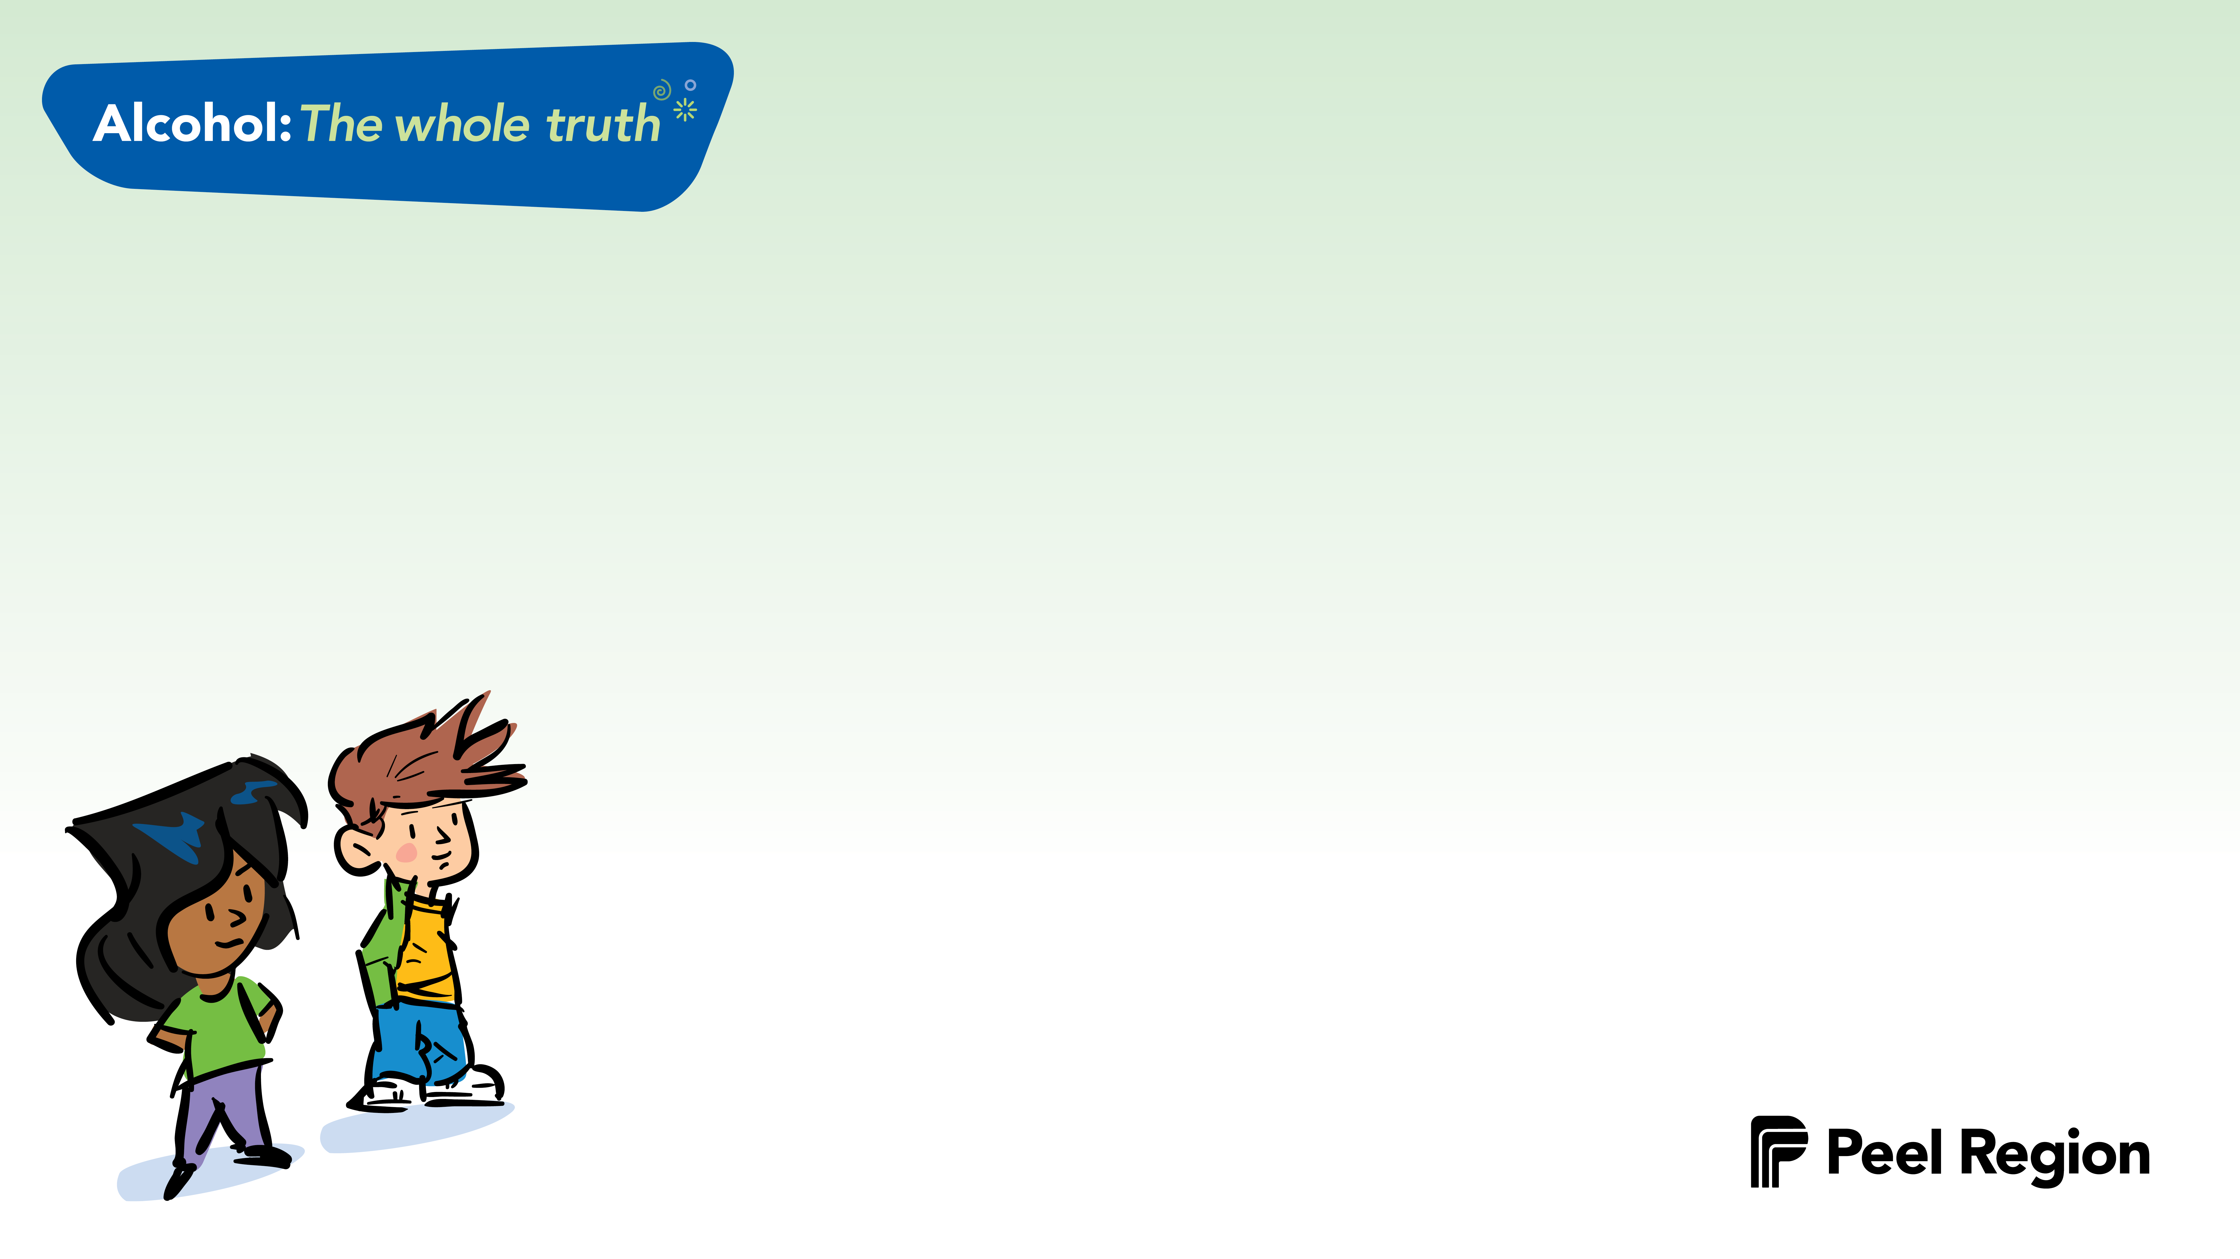
All About Alcohol Trivia
ABOUT ALCOHOL | EFFECTS | THE LAW | SAFETY FIRST
$100 | $100 | $100 | $100
$200 | $200 | $200 | $200
$300 | $300 | $300 | $300
$400 | $400 | $400 | $400

Slide 2
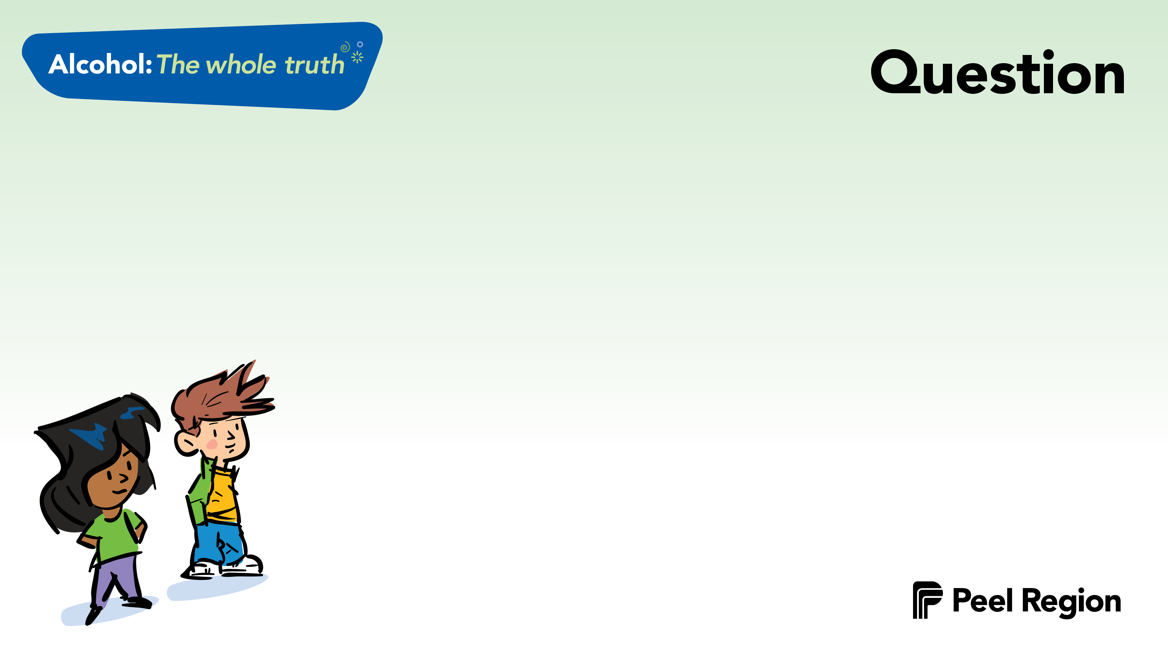
What is the most used drug amongst youth?

Slide 3
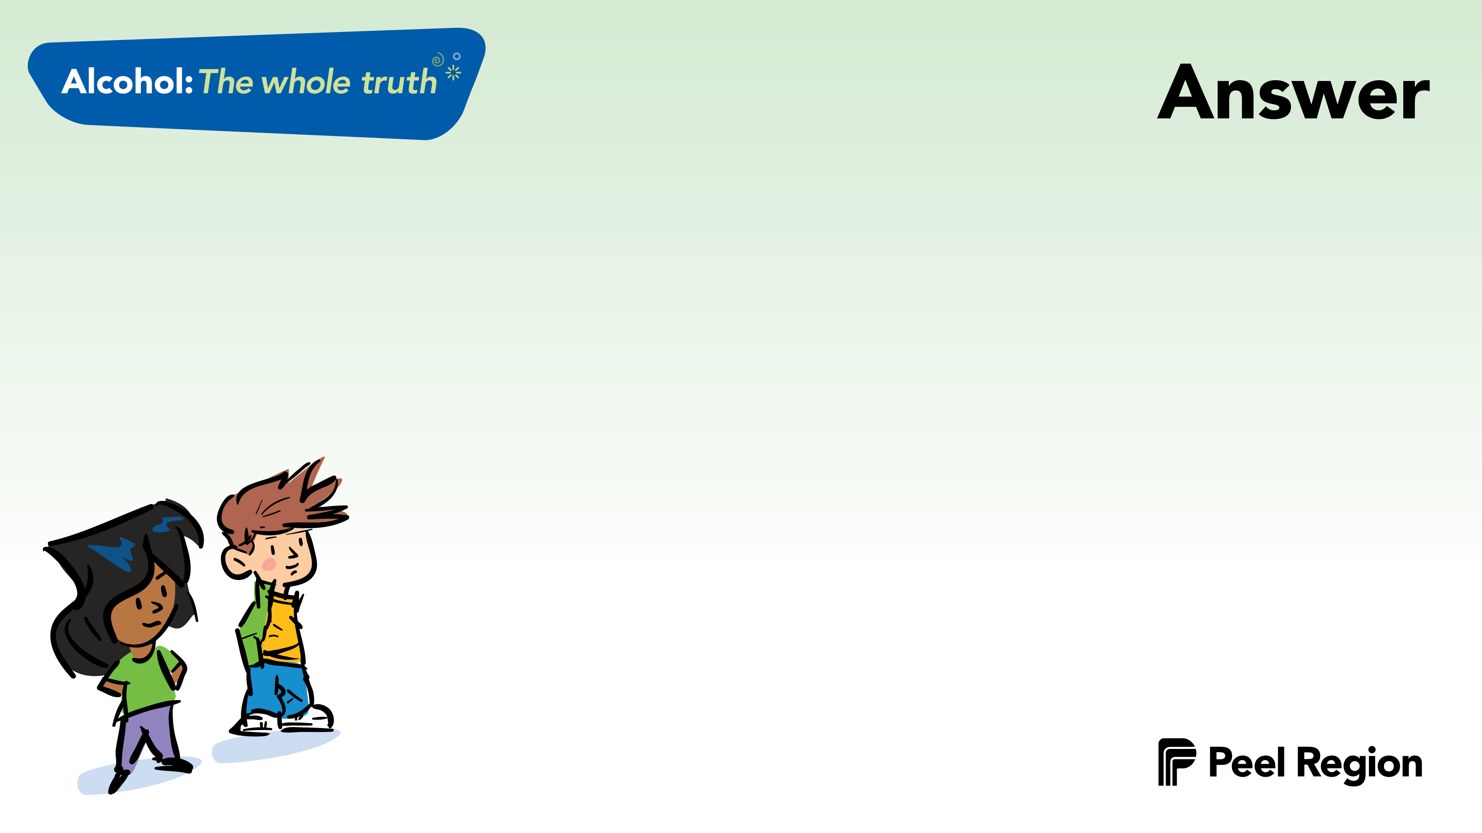

Alcohol

Slide 4
There are 3 categories of drugs:
stimulants (uppers)
depressants (downers)
hallucinogens (all-arounders)
What category is alcohol in?

Slide 5
Depressants
Alcohol slows down parts of your brain and body.

Slide 6
Beer is a kind of alcohol.
Name 2 other kinds of
alcoholic drinks.

Slide 7
Wine
Spirits (whisky, vodka, gin)
Coolers

Slide 8
Can a cold shower, a coffee, or exercise help someone “sober up”?
Explain.
Notes:
Explain “sober up”
When someone has drank alcohol, sobering up means for the effects of alcohol to wear off and the person to no longer feel the effects of the alcohol.

Slide 9
No
A coffee, a cold shower or exercise can’t help someone “sober up”.
Only TIME will help the body process the alcohol.

Slide 10
What does a depressant (downer) drug, like alcohol, do to the brain/body?

Slide 11
It slows things down.
Alcohol slows down the parts of the brain that affect your thinking and behaviour, as well as your breathing and heart rate.

Slide 12
Name one short-term and
one long-term effect of drinking alcohol.

Slide 13
Short-term: headaches, nausea (sickness), blurred vision, lack of coordination, reduced inhibitions, vomiting, blacking out.
Long-term: cancer, liver disease, death, brain damage, depression.

Slide 14
True or False:
Males and females process alcohol differently.

Slide 15
True
Males have more water in their bodies.
Females have more fat in their bodies.
Females have less of the “alcohol enzyme” (the thing that processes alcohol in the body).

Slide 16
Explain what a hangover is...

Slide 17
A hangover:
describes the unpleasant physical effects after drinking too much alcohol.
often includes headaches, nausea, vomiting, sensitivity to light and noise, tiredness, diarrhea.

Slide 18
Explain why drinking alcohol
and driving is a bad decision.

Slide 19
Drinking alcohol and
driving is a bad idea because:
- You can cause an accident.
- You can kill yourself; you can kill someone else.
- It’s 100% preventable.
Notes:
100% preventable: there are other options instead of drinking and driving
-taking a taxi
-having someone be the designated driver and not drink alcohol
-stay over at the house
-walk

Slide 20
What is the legal drinking age in Ontario?

Slide 21
In order to buy or drink alcohol, you must be:
19 years old in Ontario
Notes:
21 years old in the US
18 years old in Quebec

Slide 22
True or False:
Alcohol is one of the most dangerous drugs.

Slide 23
True
Alcohol is the #1 cause of
death amongst youth.
Some reasons are:
- drinking and driving - injury
- violence - falls
- drowning - fires

Slide 24
Is it ok for you to take an alcoholic drink from your best friend’s parents?
Explain why or why not.

Slide 25
It is illegal for you to take or for your friend’s parents to give you alcohol because you are under the legal drinking age.
Notes:
Legal: it is legal for your own parents to give you alcohol in your own home.
Legal drinking age 19yrs

Slide 26
Why is it ok for adults to
drink and not for youth
to drink alcohol?

Slide 27
Alcohol is a drug.
It affects the brain and the body.
For adults
their bodies and brains are fully developed.
For youth
their bodies and brains are still developing, so putting alcohol into the body/brain will affect how they grow and develop. Drinking alcohol could have permanent effects.

Slide 28
Name 2 places or people
where someone could go for help.

Slide 29
Family (parents, grandparents, cousins etc.)
Any adult you trust (teacher, coach, counselor, family member, etc.)
Community agencies
Telephone help lines (Kids Help Phone)
Churches/Mosques/Synagogues etc.
Public Health Unit

Slide 30
Who does the media target
with their advertisements
for alcohol?

Slide 31
Youth

Slide 32
What is alcohol poisoning?
BONUS 100 points if you can name 1 sign of someone who has alcohol poisoning.

Slide 33
Alcohol poisoning occurs when someone has drunk too much alcohol, and their body can't process it. You can die from alcohol poisoning.
It is any one of the following signs:
vomiting while asleep
won’t wake up
slow breathing / slow pulse
cold, pale or bluish skin

