Slide 1
Contract 2: East to West Diversion Sanitary Trunk Sewer Construction
Virtual Public Information Event
July 2021
Notes:
Hello and welcome to this virtual public information event. As you may know, the Region of Peel is completing sewer system improvements that will provide short- and long-term benefits to the community of Meadowvale. The East to West Diversion Sanitary Trunk Sewer Construction project will contribute to these improvements. This presentation describes the project, its benefits, as well as potential impacts to you and other community members. As always, we welcome your questions and input on this work.

Slide 2
East to West Diversion Sanitary Trunk Sewer Project
Project description and purpose
Impacted areas and locations
Types of impacts and how we have planned to reduce them
Project schedule
Keeping you informed
Notes:
This presentation will:
Describe the East to West Diversion Sanitary Trunk Sewer project, including its purpose and benefits
Explain the work that is planned at three locations, specifically Gooderham Estate Boulevard and Old Derry Road, Willow Lane, and Lamplight Way
Describe the type of impacts that community members may experience and how these potential impacts are being addressed
Provide an overview of the schedule
Outline the Region’s ways for you to stay updated on this project. You will be provided with a few options on how you can provide your feedback to us at the end of the presentation.

Slide 3
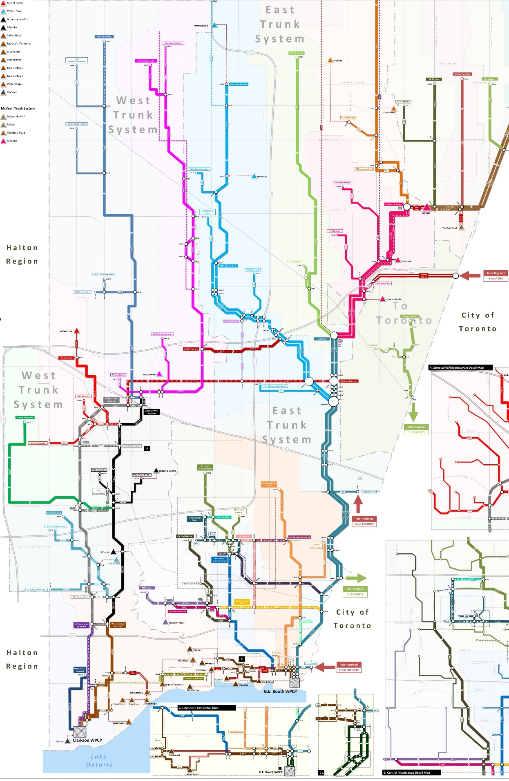
This project will allow the Region to divert wastewater to create a more resilient and flexible sewer system, which will be able to accommodate new growth.
Notes:
This project involves the construction of a trunk sewer that is 2.4 meters in diameter. This will allow the Region to divert wastewater flows from the eastern sanitary trunk system to the western sanitary trunk system. This will in turn help the Region balance flows in the collection system and allow the wastewater plants to accommodate planned future growth.
The diversion will provide additional operational flexibility for the maintenance of the Region’s critical sanitary sewer infrastructure and make the system more resilient to climate change and extreme wet weather events.

Slide 4
Project description
East - West Diversion
Contract 2
Pressurized Sanitary Sewer
East - West Diversion
Contract 1
East - West Diversion
Contract 2
This project extends along Derry Road, Old Derry Road, Old Creditview Road, and Creditview Road from just east of Bramalea Road to Argentia Road.
Realignment of the Credit Valleys
Sanitary Trunk Sewer
Notes:
The 2.4-meter diameter trunk sewer (shown in purple in this figure) will extend along Derry Road, Old Derry Road, Old Creditview Road, and Creditview Road from just east of Bramalea Road to Argentia Road.
Due to the scale of the project, the work has been divided into two contracts.
Contract 1 work started in October 2020 and is ongoing. This segment runs along Derry Road from Mavis Road to just east of Dixie Road
Contract 2 is made up of two segments as shown on this map. Work on the segment on the left will impact the Meadowvale community and is anticipated to start by the end of calendar year 2021.
This work is currently being approved by regulatory bodies, such as the Credit Valley Conservation, the Ministry of Environment, Conservation and Parks, the Department of Fisheries and Oceans, and the City of Mississauga’s Heritage Advisory Committee.
In addition to the construction planned for Contract 2, as a result of the Highway 401 widening project by the MTO, there are two other components to the project.
One component involves the realignment of the existing 1.5-m diameter Credit Valley Sanitary Trunk Sewer.
and the other is the construction of a pressurized sanitary sewer at Willow Lane.

Slide 5
Contract 2 Construction will impact three areas
Location 2
Location 1
Location 3
Location 1: Site 5A at Old Derry Road and Gooderham Estate Boulevard (for construction of the East to West Diversion Sanitary Trunk Sewer)
Location 2: Willow Lane (for the pressurized sanitary sewer)
Location 3: Lamplight Way (to create a temporary access road to the realignment of the Credit Valley Sanitary Trunk Sewer)
Notes:
Trenchless construction will be used where possible to reduce (or mitigate) impacts.
This figure shows the three project sites, specifically:
Location 1 - Site 5A at Gooderham Estate Boulevard, which involves the construction of the East to West Diversion Sanitary Trunk Sewer
Location 2 - Willow Lane, which is where the pressurized sanitary sewer will be installed
Location 3 - Lamplight Way, which will be used as a temporary access road during the realignment of the Credit Valley Sanitary Trunk Sewer

Slide 6
Location 1: Old Derry Road and Gooderham Estate Boulevard
Type of Impact
Construction within an easement on the southwest corner of the intersection will result in:
Closure of Gooderham Estate Boulevard (including sidewalk on west side) – 1 to 2 years
Diverted bus route
Accesses to work zone
Construction traffic
Construction noise
Notes:
Location 1 is the site of the existing local sanitary sewer on Gooderham Estates Boulevard. At this location, a diversion chamber will be constructed that will intercept and divert some of the wastewater flow to the East to West Sanitary Trunk Sewer. This figure shows the construction location circled in the bottom, left corner of the intersection of Gooderham Estates Boulevard and Old Derry Road West. The dashed lines surrounding the circle are the construction limits.
Although residents will continue to have local road access, potential impacts related to construction are:
Closure of Gooderham Estate Boulevard, including the sidewalk on the west side, between Old Derry Road and north of Buttle Station Place for approximately one year.
Diversion of MiWay bus routes 57 and 61 required by the road closure
Work zone access will be via the Old Derry Road and Gooderham Estate Boulevard and on Gooderham Estate Boulevard south of Old Derry Road.
Construction traffic into and out of the site.
Construction noise.

Slide 7
Location 1: Old Derry Road and Gooderham Estate Boulevard
Actions Taken to Reduce Impacts to the Community
Reroute traffic
Reroute MiWay bus routes 57 and 61
Add AODA compliant temporary pedestrian platform
Provide signage to indicate sidewalk closure
Construction fencing for noise control
Provide dust and mud control
Notes:
The Region of Peel will implement measures to reduce (or mitigate) impacts at Location 1.
Measures that will be implemented during construction include:
Rerouting traffic through a detour
Rerouting MiWay bus routes number 57 and 61
Adding a temporary pedestrian platform to cross Old Derry Road from Gooderham Estate Boulevard’s east sidewalk. This platform will be compliant with the Accessibility for Ontarians with Disabilities Act. Clear signage will also be installed to indicate sidewalk closure.
Installing a temporary fence-like structure around the construction area, to help dampen and contain construction noise.
Controlling for dust and mud throughout the construction phase.

Slide 8
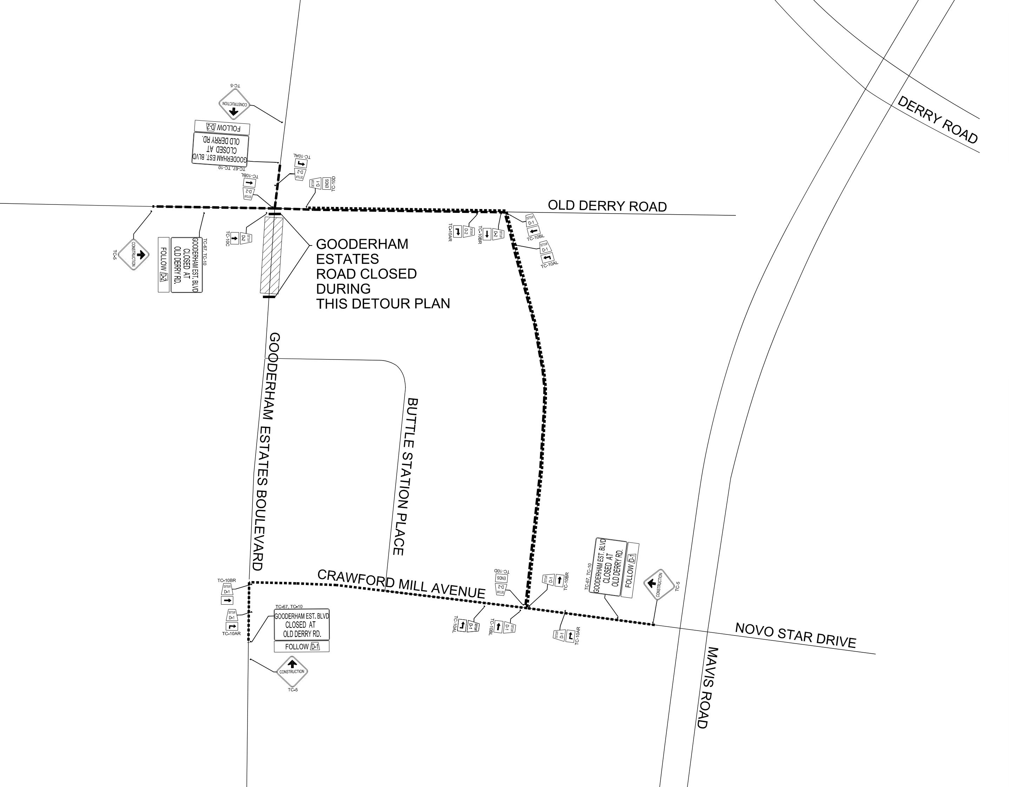
Road detours and bus route shifts will occur during construction at Old Derry Road and Gooderham Estate Boulevard
Local Traffic Detour During Construction
Notes:
As shown in this figure, road detours and bus route shifts will occur during construction at Old Derry Road and Gooderham Estate Boulevard
To reduce traffic related impacts for community members:
Local traffic will be detoured through Elliott Parliament Street and Crawford Mill Avenue with proper signage; major traffic will be directed towards major roadways. The detour is shown in black in the figure on this slide.
MiWay will determine detour routes for Bus Routes 57 and 61

Slide 9
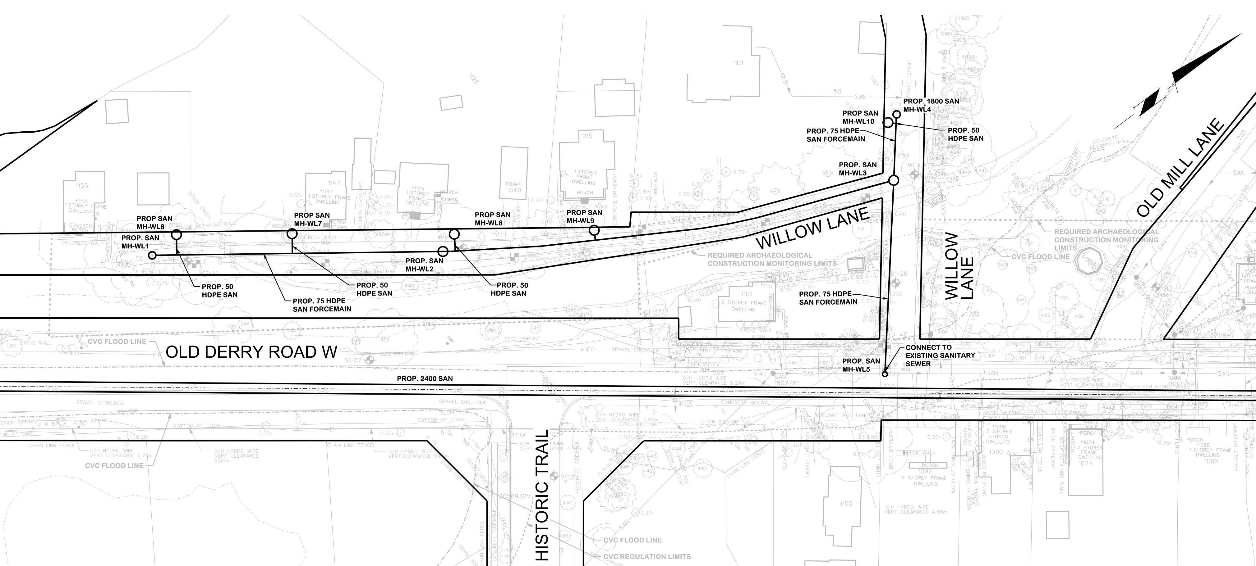
Location 2: Old Derry Road and Willow Lane
Type of Impact
Construction – using less invasive trenchless technology – will involve installing a pressurized sewer pipe and will result in:
Road closure of Willow Lane – 4 months
Traffic restrictions at Old Derry Road and Willow Lane
Impact to emergency services (EMS)
Coordination with homeowners of restricted vehicular access
Construction noise
Notes:
Location 2 lies at Old Derry Road and Willow Lane. Homes along Willow Lane are on a septic system. Residents are interested in having the ability to connect to the Region’s sewer system; this project would allow for this access.
This location is unique in that Willow Lane is narrow and within the Meadowvale Village Heritage Conservation District. Rather than digging trenches to install the new sewer pipe, we plan to use tunneling methods to create as little disturbance as possible. Maintenance holes will be installed to each of the homes within the existing road right-of-way to permit residents to connect their service at a future date.
While the service is being provided by the Region, the residents will be responsible for their own individual connections to the new, low pressure, sewer pipe. This will require that residents make plumbing changes, install a grinder sewage pump, and abandon their septic systems. The homeowner is responsible for arranging and paying for this work.
The pressurized sanitary sewer is only viable if all of the homes are connected and will subject the homeowner to paying the Region for wastewater services.
There will be significant impacts to the residents during this work.
The narrow nature of Willow Lane means that access to homes will be impacted during construction. Willow Lane will need to be closed during this time. The work is expected to take approximately 4 months.
Traffic restrictions at Old Derry Road and Willow Lane will be implemented to facilitate the installation of the pressurized sewer pipe.
Coordination with homeowners and residents is required for emergency services as the road is very narrow.
Coordination will be needed with homeowners to restrict vehicular traffic during the work period.
Construction work will generate noise.

Slide 10
Location 2: Old Derry Road and Willow Lane
Actions Taken to Reduce Impacts to the Community
Coordinate pedestrian access
Provide alternative parking for local residents’ vehicles
Coordinate construction work with EMS
Install construction fencing and signage
Provide dust and mud control
Notes:
As with Location 1, the Region of Peel is taking measures to reduce impacts to the community at Location 2.
These include:
Coordinating pedestrian access on Willow Lane during construction due to the narrow width of the road.
Providing alternative vehicle parking for local residents on the north side of Old Derry Road opposite the Historic Trail.
Coordinating construction work with EMS. The contractor will suspend work and move equipment out of way as required to facilitate access.
Installing appropriate construction fencing and signage.
Providing dust and mud control throughout the construction phase.

Slide 11
Location 3: Lamplight Way
Type of Impact
Construction of a trunk sewer and its crossing of Highway 401 will have temporary impacts including:
Removal of cul-de-sac
Installation of construction access gate
Increased traffic
Notes:
Location 3 is located at Lamplight Way. The residents of Lamplight Way will be impacted by construction truck traffic. These trucks will need to access Site 8, located just north of Highway 401.
A temporary road will be constructed along the existing easement of the trunk sanitary sewer from the west end of Lamplight Way to facilitate the re-construction of the 1.5-meter diameter Credit Valley Sanitary Trunk Sewer and the crossing of Highway 401. This work is required due to the widening of the highway by the MTO as the current infrastructure cannot be safely accessed and maintained by the Region’s operations and maintenance staff.
While construction will not occur at Location 3 at Lamplight Way, there are anticipated temporary impacts which include:
Removal of the cul-de-sac at the end of the road.
Installation of an access gate at the end of the road.
Increased traffic, including construction vehicles, entering and exiting the site.

Slide 12
Location 3: Lamplight Way
Actions Taken to Reduce Impacts to the Community
No construction within the road
Restore cul-de-sac to original condition
Have full-time traffic flag person at construction access gate
Provide for dust and mud control
Limit contractor access times
Restrict operation of heavy vehicles to 7am to 7pm
Notes:
As noted, although construction will not occur on Lamplight Way, we are enacting measures to reduce impacts in the area. These measures include:
Restoring the cul-de-sac to its original condition after construction is complete
Having a full-time traffic flag person stationed at the construction access gate to mitigate traffic impacts
Providing dust and mud control measures throughout the construction phase.
Limiting contractor access time
Restricting the operation of heavy vehicles on Lamplight Way to 7am to 7pm.

Slide 13
Project Schedule
The final schedule will be coordinated between contractor, regulatory bodies, and Region’s operational requirements.
Site |  | 2021 |  |  |  | 2022 |  |  |  | 2023 |  |  |  | 2024 |  |  |  | 2025 |  |  |  | 2026
 |  | Q1 | Q2 | Q3 | Q4 | Q1 | Q2 | Q3 | Q4 | Q1 | Q2 | Q3 | Q4 | Q1 | Q2 | Q3 | Q4 | Q1 | Q2 | Q3 | Q4 | Q1 | Q2 | Q3 | Q4
Detailed Design & Approvals
Contract 2
Old Derry Road and Gooderham Estate Boulevard | Utility Relocates |  |  |  |  |  |  |  |  |  |  |  |  |  |  |  |  | 9 months
 | Construction |  |  |  |  |  |  |  |  |  |  |  |  |  |  |  |  | 12- 18 months
Lamplight Way | Construction |  |  |  |  |  |  |  |  |  |  |  |  |  |  |  |  | 18-24 months
Old Derry Road and Willow Lane | Construction |  |  |  |  |  |  |  |  |  |  |  |  |  |  |  |  | 3-4 months
Notes:
While the East to West Sanitary Trunk Sewer project will take many years to complete, we have tried to identify the construction time frames for each of the areas discussed in this presentation. The exact timing however, may vary from the schedule presented, as it is subject to regulatory approvals. The final construction schedule will be determined once the contractor has been retained by the Region.
The work is to be tendered in the fall of this year. Construction activities for the impacted areas are anticipated to take place primarily during 2022 and 2023.

Slide 14
We are committed to keeping you informed
Receive timely project updates right to your inbox by signing up for e-notices at peelregion.ca/construction
Visit the Project Webpage for updates
We will deliver more detailed information to homes within the construction zone closer to the proposed construction date
If you would like to speak with us about this work, please contact us:
Email: construction@peelregion.ca
Phone: 905-791-7800 ext. 4409
Notes:
The Region of Peel is committed to keeping you informed about this project.
More detailed project information will be delivered to homes within the construction zone closer to the proposed construction date.
In the meantime, if you would like to receive project updates, sign up for e-notices at peelregion.ca/construction
If you would like to ask a question about the project or speak with us about this work, please contact us:
Email: construction@peelregion.ca
Phone: 905-791-7800 ext. 4409
You may also provide feedback on this project through our website, our Twitter handle @peelpublicworks, or our Facebook page.
Thank you.

