Slide 1
Schedule ‘B’ Municipal Class Environmental Assessment: New Watermain South of Williams Parkway
Online Public Engagement
November 11, 2021

Slide 2
Welcome!
The Purpose of this Online Public Engagement is to:
Project Overview
Receive Feedback
Next Steps
Provide a project overview and explain why the project is being undertaken.
Provide details and seek input on the alternative solutions developed
Provide information on the next stages of the project.

Slide 3
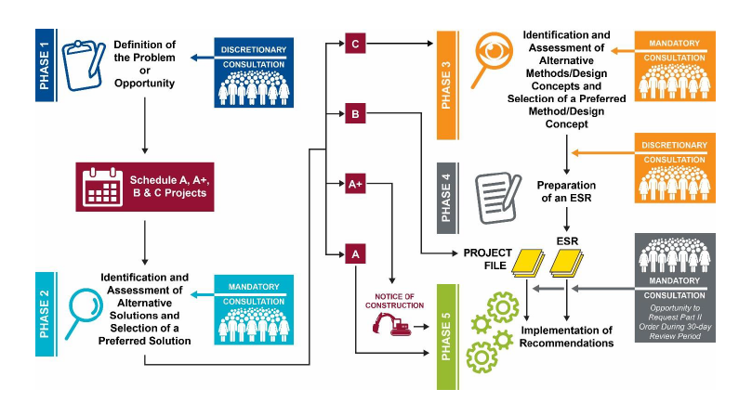
New Watermain South of Williams Parkway Schedule ‘B’ Municipal Class Environmental Assessment (EA)
Environmental Assessment initiated in 2019
Phase 1 has been completed
Currently in Phase 2 evaluation of alternatives and recommendation of a preferred solution

Slide 4
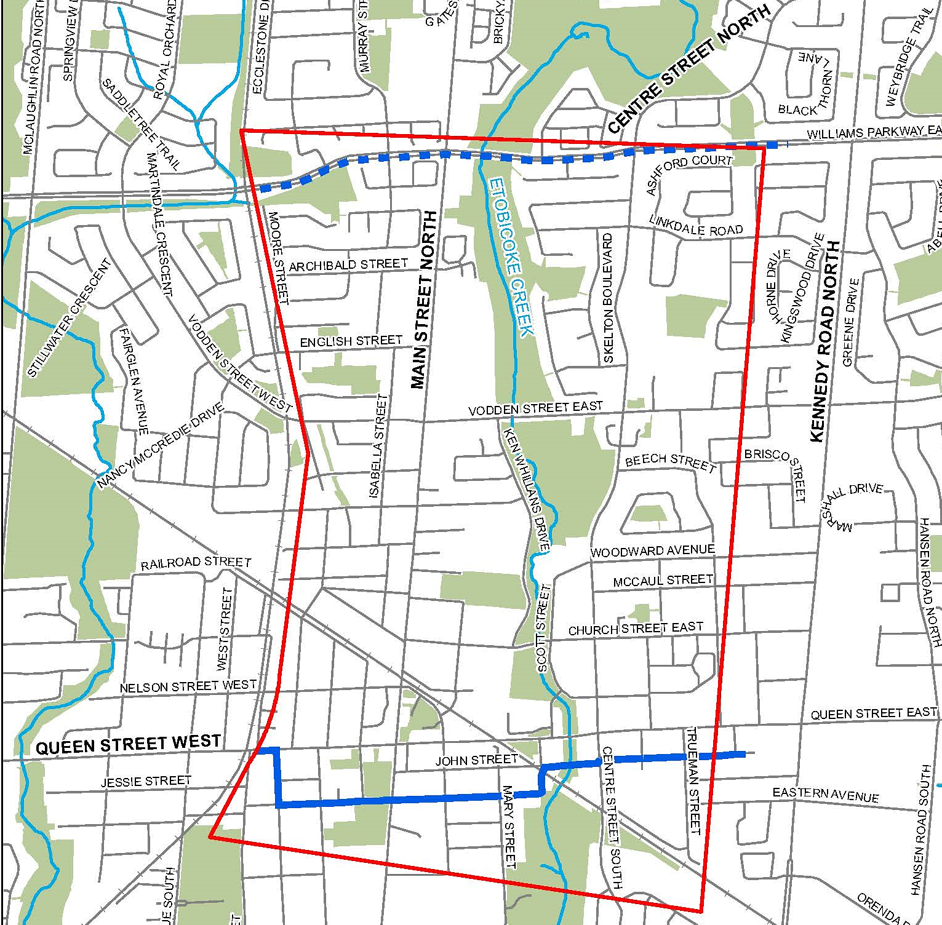
Project Overview
900 mm transmission main (future) along Williams Parkway
The Region’s recently completed Water and Wastewater Master Plan confirmed the need for additional water supply to the downtown Brampton area.
The new watermain would connect to a new transmission main to be constructed along Williams Parkway and the existing watermain along Wellington St. and John St.
A Schedule ‘B’ Municipal Class Environmental Assessment (EA) Study is taking place to identify the preferred alignment for the new watermain.
Existing 600 mm watermain along Wellington Street and John Street

Slide 5
Problem Statement: Why are we doing this?
The existing water supply system in Brampton doesn’t have enough capacity to accommodate the additional water demand for future growth in the downtown area.
This EA study will identify preferred routing for the new watermain to minimize impacts on the community and provide long-term flexibility to manage demand and pressure in the system.
Construction of new watermain will proceed after new transmission main is constructed along Williams Parkway (2022-2025).
Identification of routing for the watermain allows for integration with future Region and City initiatives underway in the Community.

Slide 6
Identification of Alternatives

Slide 7
Short List Alternatives
Alternative 1 – Centre Street
Alternative 2 – Centre Street and Beech Street
Alternative 3 – Main, Vodden and Centre Street
Alternative 4 – Main Street and Mill Street
Alternative 5 – Main, Church and Centre Street
Alternative 6 – West Neighbourhood Route

Slide 8
Alternative 1 – Centre Street
Description:
Approximately 2100 linear meters with route alignment along Centre Street right of way
Connection points at Williams Parkway and John Street
Interconnection at 600 mm watermain on Vodden Street, proposed 600 mm watermain at Church Street, 400 mm watermain at Woodward Avenue and 600 mm watermain on Queen Street
Micro-tunnel construction of full alignment
Micro-Tunneled
Open Cut
Interconnection

Slide 9
Alternative 2 – Centre Street and Beech Street
Description:
Approximately 2400 linear meters with route alignment along Centre Street and Beech Street right of way
Connection points at Williams Parkway and John Street
Interconnection at 600 mm watermain on Vodden and 600 mm watermain on Queen Street
Open cut construction on Beech Street and micro-tunnel construction on Centre Street
Micro-Tunneled
Open Cut
Interconnection

Slide 10
Alternative 3 – Main Street, Vodden Street and Centre Street
Description:
Approximately 2780 linear meters with route alignment along Main Street, Vodden Street and Centre Street right of way
Connection points at Williams Parkway and John Street
Interconnection to 600 mm watermain on Vodden Street, 600 mm watermain on Queen Street and proposed 600 mm watermain on Church Street
Open cut construction on Main Street and Vodden Street with micro-tunnel construction on Centre Street and Etobicoke Creek crossing
Micro-Tunneled
Open Cut
Interconnection

Slide 11
Alternative 4 – Main Street and Mill Street
Description:
Approximately 2380 linear meters with route alignment to be along Main Street, Vodden Street, Isabella Street, Rosedale Street, and Mill Street right of way
Connection points at Williams Parkway and Queen Street
Interconnection to 600 mm watermain at Vodden Street
Open cut construction with micro-tunnel crossing of the rail line and micro-tunnel construction on Isabella Street, Rosedale Street and Mill Street North
Micro-Tunneled
Open Cut
Interconnection

Slide 12
Alternative 5 – Main Street, Church Street, and Centre Street
Description:
Approximately 2710 linear meters with route alignment to be along Main Street, Church Street and Centre Street right of way
Connection points at Williams Parkway and John Street
Interconnection to 600 mm watermain at Vodden Street, future 600 mm watermain on Church Street at Main Street and Centre Street intersections and 600 mm watermain at Queen Street
Open cut construction with micro-tunnel crossing of Etobicoke Creek and micro-tunnel construction on Centre Street
Micro-Tunneled
Open Cut
Interconnection

Slide 13
Alternative 6 – West Neighbourhood Route
Description:
Approximately 2600 linear meters and follows smaller residential streets west of Main Street (Murray, Garden, Bagshot, Archibald, Murray, English, Isabella, Rosedale, Mill Street)
Connection points at Williams Parkway and Queen Street
Connection to 600 mm watermain at Vodden Street
Open cut construction with micro-tunnel crossing of rail line and micro-tunnel construction on Isabella Street, Rosedale Street, Mill Street North
Micro-Tunneled
Open Cut
Interconnection

Slide 14
Evaluation of Alternatives

Slide 15
Evaluation of Alternatives
Category | Evaluation Criteria | Alternative No. 1 | Alternative No. 2 | Alternative No. 3 | Alternative No. 4 | Alternative No. 5 | Alternative No. 6
Technical Considerations | Technical viability/constructability Access for construction and maintenance Impact to existing and future infrastructure Permit and approval requirements Future operations and maintenance
Natural Environment | Disturbance of terrestrial species and features Disturbance of aquatic species and features Direct effects on terrestrial species at risk Direct effects on aquatic species at risk Effects on water quality or quantity
Socio-Cultural Environment | Traffic disruption during construction Impacts to heritage or cultural resources Property acquisition and easement requirements Compliance with Master Plan and growth initiatives Impacts to parks and community open spaces
Economic Factors | Construction costs Operation and maintenance (O&M) costs
Alternative Ranking |  | 1 | 2 | 4 | 5 | 3 | 6
Most Favourable |  | Moderately Favourable |  | Least Favourable

Slide 16
Summary Score of Alternatives
 | Alternative No. 1 | Alternative No. 2 | Alternative No. 3 | Alternative No. 4 | Alternative No. 5 | Alternative No. 6
Overall Score | Most Favourable | Moderately Favourable | Moderately Favourable | Least Favourable | Moderately Favourable | Least Favourable
Key Factors | Shortest direct connection to existing and future watermains Trenchless construction to avoid impact on mature trees and existing utilities Less traffic impact More expensive due to trenchless construction | Direct connection to future watermains Less opportunity to connect to existing watermains Traffic impact on Beech Street for open cut construction Less expensive due to open cut portion | Direct connection to future watermains Trenchless crossing of Etobicoke Creek Traffic impact on Vodden Street and Main Street for open cut construction Longer route but less expensive due to open cut portion | Direct connection to future watermains Less opportunity to connect to existing watermains Trenchless crossing of rail line Traffic impact for open cut construction Longer route but less expensive due to open cut portion | Direct connection to future watermains Trenchless crossing of Etobicoke Creek Traffic impact on for open cut construction Longer route but less expensive due to open cut portion | Less Direct connection to existing and future watermains Trenchless crossing of rail line required Traffic impact on multiple streets for open cut construction Longer route but less expensive due to open cut portion

Slide 17
Recommended Preferred Alternative
Alternative 1 – Centre Street is recommended as the preferred alternative
No creek or rail crossings, which reduce permitting requirements and impacts to the natural environment
Trenchless construction reduces impact on existing tree and existing utilities
Short-term traffic and property impacts may occur at tunnel shaft locations
Interconnection

Slide 18
Next Steps
December 2021
Receive input from the public and stakeholders
January 2021
Finalize the preferred alternative
Prepare and publish the Project File for review
Issue Notice of Completion of Class EA

Slide 19
How to Stay Connected and Involved?
Feedback on this Online Public Engagement is open until December 2, 2021
Please contact:
Jimmy Cheema
Project Manager
905-791-7800 Ext. 5403
Jimmy.Cheema@peelregion.ca
*Feedback collected on this project will conform with the Freedom of Information and Protection of Privacy Act. It will be documented as part of this project and may be publicly available.

