Slide 1
Etobicoke Creek Trunk Sewer Improvements and Upgrades Schedule C Municipal Class Environmental Assessment
Online Public Engagement
November 26, 2020

Slide 2
Welcome!
The Purpose of this Online Public Engagement is to:
Project Overview
Receive Feedback
Next Steps
Provide a project overview and explain why the project is being undertaken.
Provide details and seek input on the alternative solutions developed
Provide information on the next stages of the project.

Slide 3
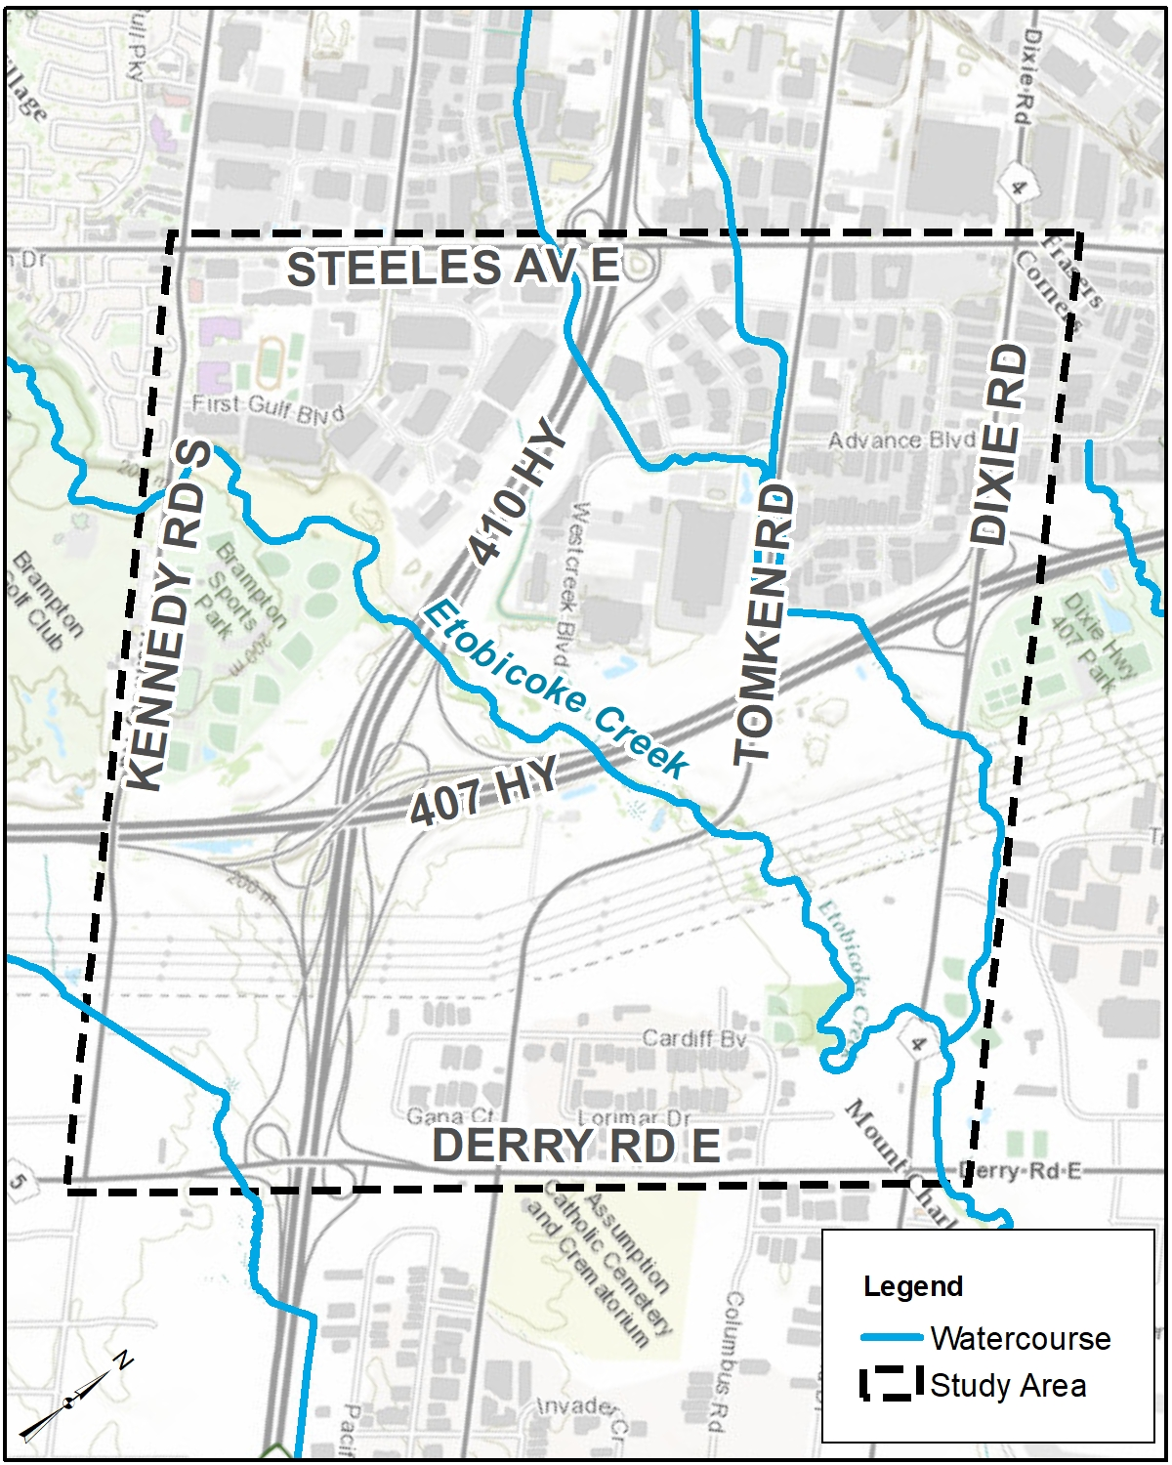
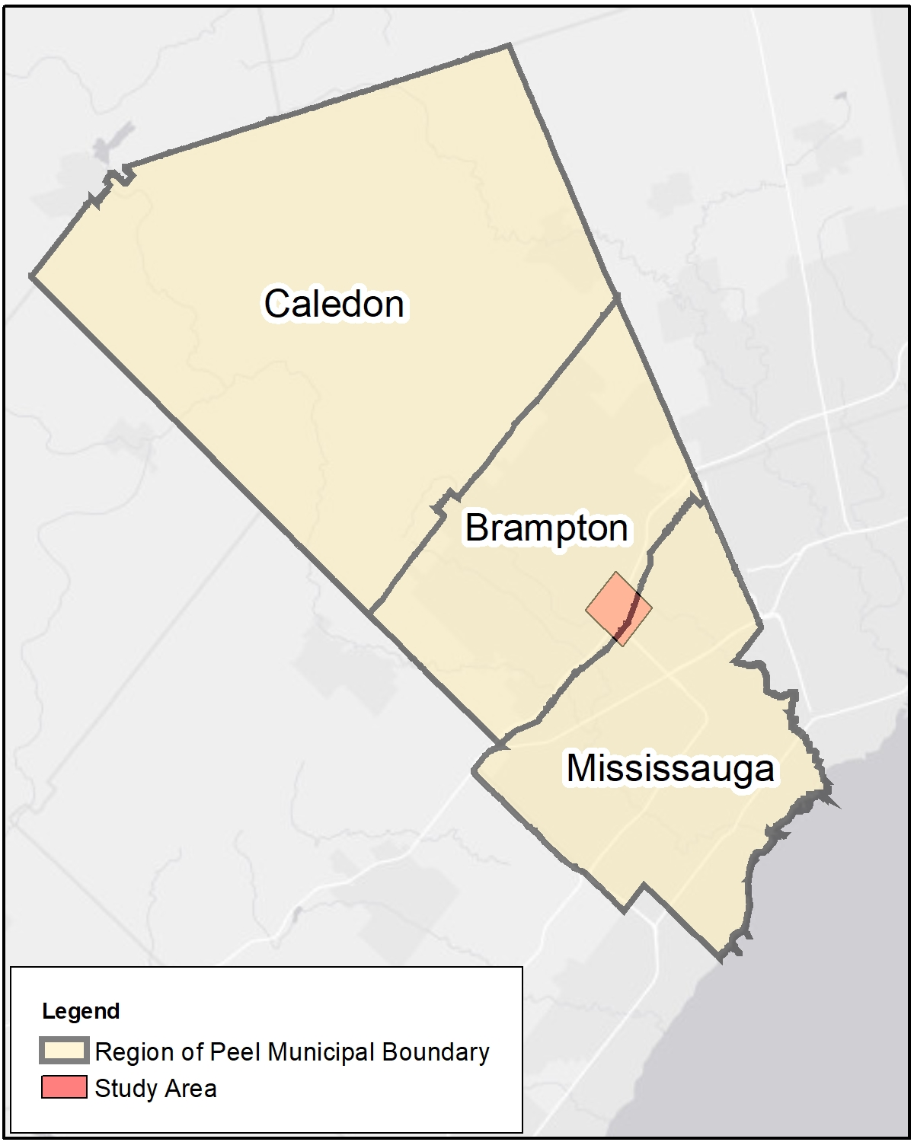
Project Overview: What, why and how?
The Etobicoke Creek Trunk Sanitary Sewer, from Kennedy Road to Derry Road in the City of Brampton, provides service to a large area extending north of Mayfield Road
Upgrades are required to address issues with the existing sanitary sewers and provide reliable sanitary service to future growth forecasted for the area.
A Schedule ‘C’ Municipal Class Environmental Assessment (EA) Study is being undertaken to identify the preferred means to implement these upgrades.

Slide 4
Class Environmental Assessment Process
We Are Here !

Slide 5
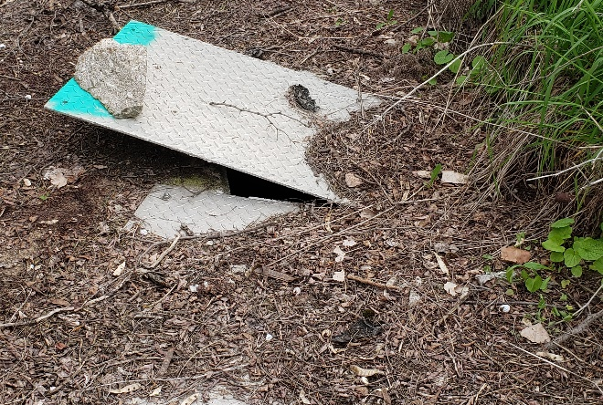
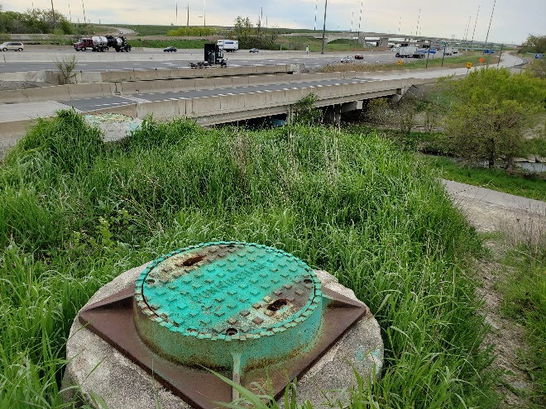
Problem Statement: Why are we doing this?
“A review of the condition and capacity of the existing Etobicoke Creek Trunk Sewer reveals that while the existing sewer is in relatively good condition with isolated areas requiring structural repair or operational and maintenance attention, repair or rehabilitation would not address the operational challenges posed by deep manholes, access limitations and proximity to Etobicoke Creek.
The sewer is considered to be constrained conveying existing flows along approximately 28% of its length and would be unable to accommodate the growth forecasts developed in alignment with City of Brampton’s growth plans.“

Slide 6
Alternative Development Process: How do we arrive to a solution?
Step 1: Identify and screen servicing strategies to address the problem statement, using Pass/Fail criteria
Step 2: Identify and evaluate long list of servicing concepts & routes to achieve the strategy using screening level assessment
Step 3: Evaluate viability and feasibility of short list of alternatives using detailed triple bottom line (TBL+) evaluation
Step 4: Consult and receive input to select the preferred alternative.
Long List of Concepts Alternatives
Screening Level Assessment
Shortlist of Viable Alternatives
Detailed TBL+ Evaluation
Preliminary Preferred Alternative
Preferred Alternative
Public and Agency Review
Servicing Strategies
Pass/Fail Criteria

Slide 7
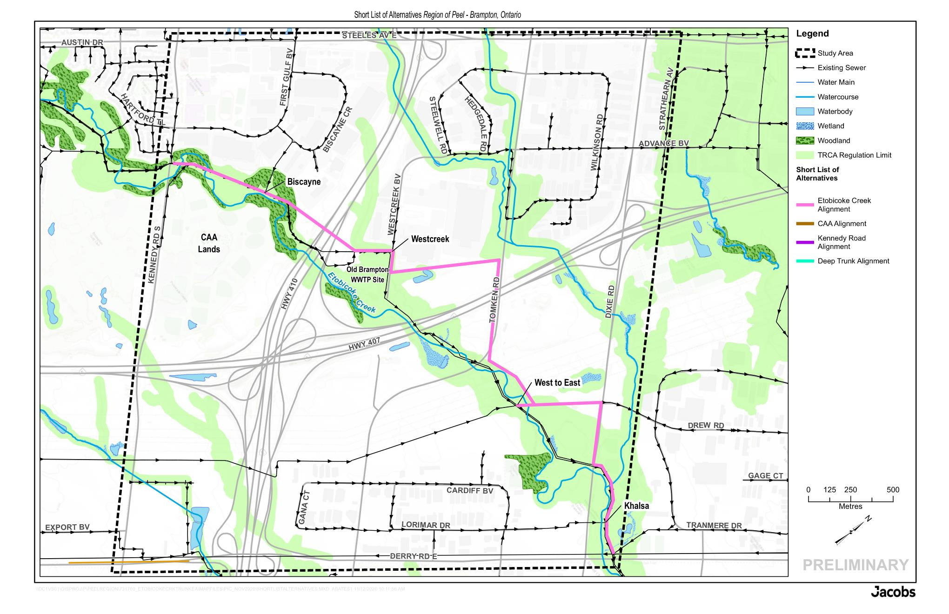
Etobicoke Creek Alignment
Approximately 0.5 km of 1350 mm diametre pipe and 4.1 km of 1500 mm diametre pipe
Mainly open-cut
Crossings of Highways 407 and 410 to be tunneled
First and last segments follow existing alignment in the creek valley with remainder routed outside the valley, requiring private property negotiation
Diversion chamber at Biscayne
Connects to existing Etobicoke Creek trunks at Derry Rd to maintain conveyance to Eastern Sanitary Trunk System

Slide 8
CAA Alignment
Approximately 0.7 km of 1350 mm diametre pipe and 4.1 km of 1500 mm diametre pipe
Mainly open-cut
Crossings of Highways 407 and 410 to be tunneled
First segment is routed on future north road of CAA Development
Majority of remaining alignment is routed out of creek valley, requiring private property negotiation
Diversion chamber at Biscayne
Connects to existing Etobicoke Creek trunks at Derry Rd to maintain conveyance to Eastern Sanitary Trunk System

Slide 9
Kennedy Road Alignment
Approximately 2.5 km of 1500 mm diametre pipe
Mainly tunneled; small section to be open cut for Biscayne connection
Approx. 800 m connection from Biscayne to Kennedy Rd to provide solution to existing flow constraints
Main trunk to be within Right of Way of Kennedy Road
Minimizes construction in Toronto Region Conservation Authority (TRCA) regulated areas
Will connect downstream to East-West Diversion Sanitary Trunk Sewer

Slide 10
Deep Trunk Alignment
Approximately 3.7 km of 1500 mm diametre pipe
Mainly tunneled; small open cut section for Biscayne connection (135 m)
Within TRCA regulated area but tunneled to minimize impact on creek
Opportunity to have tunneling compound on the Old Brampton Wastewater Treatment Plant site
Tunnel compound needed between Tomken Rd and Dixie Rd
Connects to existing Etobicoke Creek trunks at Derry Rd to maintain conveyance to Eastern Sanitary Trunk System

Slide 11
Evaluation of Alternatives

Slide 12
Evaluation of Alternatives
Category | Evaluation Criteria | Etobicoke Creek | CAA Lands | Kennedy Road | Deep Trunk
Technical Considerations | Implementation Feasibility Permits and Approvals Reliability Effectiveness Compatibility with Existing Infrastructure Maximize Lifecyle Investment Flexibility Operational Accessibility | Most Impacts/ Least Benefits Least Preferred | Moderate Impacts/ Moderate Benefits Moderately Preferred | Moderate Impacts/ Moderate Benefits Moderately Preferred | Least Impacts/ Most Benefits Most Preferred
Natural Environment | Terrestrial Systems Aquatic Systems Soil Contamination Hydrogeology and Surface and Groundwater Soil, Bedrock and Geology | Most Impacts/ Least Benefits Least Preferred | Moderate Impacts/ Moderate Benefits | Least Impacts/ Most Benefits Most Preferred | Moderate Impacts/ Moderate Benefits Moderately Preferred
Socio-Cultural Environment | Recreational Land Uses and Visual Landscape Future Planning Policies/Initiatives Disruption During Construction Archaeological and Cultural Resources | Moderate Impacts/ Moderate Benefits Moderately Preferred | Most Impacts/ Least Benefits Least Preferred | Moderate Impacts/ Moderate Benefits Moderately Preferred | Least Impacts/ Most Benefits Most Preferred
Economic Factors | Capital Cost Operation and Maintenance | Least Impacts/ Most Benefits Most Preferred | Moderate Impacts/ Moderate Benefits Moderately Preferred | Most Impacts/ Least Benefits Least Preferred | Moderate Impacts/ Moderate Benefits Moderately Preferred
Alternative Ranking |  | 4 | 3 | 2 | 1
Most Impacts/ Least Benefits
Least Preferred
Moderate Impacts/ Moderate Benefits
Moderately Preferred
Least Impacts/ Most Benefits
Most Preferred

Slide 13
Summary Score of Alternatives
Alternatives | Etobicoke Creek | CAA Lands | Kennedy Road | Deep Trunk
Overall Score | Least Preferred | Least Preferred | Less Preferred | Most Preferred
Key Factors | Most limited access for construction & O&M Integrates with existing sewers Pumping stations required to service growth Most impact on natural environment through construction Temporary impact to the paved multiuse trail in valley and King's Park during construction May impact archaeological resources Lowest cost | Integrates with existing sewers Pumping stations required to service growth Most impact on natural environment through construction Temporary impact to the paved multiuse trail in valley and King's Park during construction Impacts existing sports field on CAA Lands May impact archaeological resources Longest alignment leads to moderate cost | Most accessible for both construction and O&M Able to service future growth without pumping stations Does not integrate well with existing sewers Impacts available capacity for Region’s diversion strategy Tunneled construction results in least impact on natural environment Temporary traffic disturbance during construction at tunnel shaft locations Shortest alignment but tunneled construction leads to highest cost | Some improvement to access for construction and O&M Able to service future growth without pumping stations Integrates with existing sewers Tunneled construction limits impact to natural features and archaeological and cultural heritage resources Trenched construction required at south end of alignment Tunneled construction leads to higher cost

Slide 14
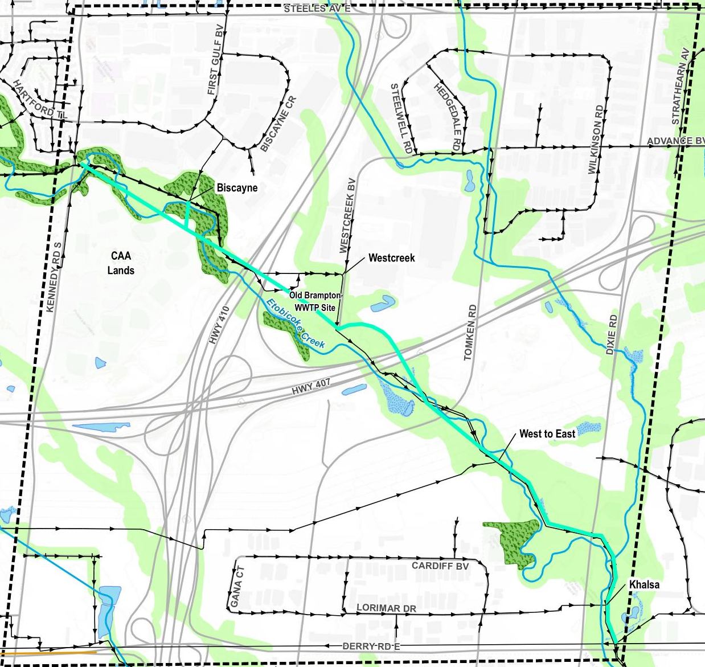
Preliminary Preferred Alternative - Deep Trunk Alignment
Services future growth via gravity and integrates with the East to West diversion strategy
Provides more connections to the existing trunk sewer system
Tunneling in creek valley will help mitigate impact to the natural environment
Access to majority of alignment will remain challenged due to location in valley
Least disturbance to community uses in the study area as Region vacant property can be used for construction staging

Slide 15
Project Progress – Where are we?
Phase 1
Phase 2
Assessment of Existing Conditions Natural Features Assessment Archaeological/Cultural Resources Assessment Identify the Problem Statement |  |  |  |  | Establish Evaluation Criteria Evaluate Alternative Solutions Incorporate Community and Stakeholders Inputs Confirm Preferred Alternative
Spring 2019 | June 29 2019 | Summer 2019 | Fall 2019 | October 2019 | Winter 2019 | Spring 2020 | Fall 2020 | November 2020 | December 2020
 | Notice of Study Commencement |  | Hydraulic Analysis |  | Identify Alternative Solutions |  |  | Present Preliminary Preferred Alternative
We Are Here !

Slide 16
Project Progress – Next Steps?
Phase 3
Phase 4
Phase 5
Undertake additional Archaeological Assessment |  |  | Document Study Outcomes in Environmental Study Report (ESR) for Review and Comment |  | Initiate Field Investigations for Preferred Design
Winter 2020 | December 2020 | March 2021 | May 2021 | May 2021 | April 2021 | August 2021
Identify and evaluate alternative means to implement preferred alternative |  | 2nd Online Public Engagement to seek Impacts of Implementation |  | Issue Notice of Completion: Opportunity to review overall project and ESR |  | Complete Preliminary Design
Based on comments received, the project can then proceed through design and anticipate construction in Fall 2024.

Slide 17
How to Stay Connected and Involved?
Send your feedback or your questions on this project to the email below before December 11, 2020
Italia Ponce, P.Eng.
Project Manager
10 Peel Centre Drive, 4th Floor, Suite A
Brampton, ON, L6T 4B9
905-791-7800 Ext. 4583
Italia.ponce@peelregion.ca
If you would like to be kept updated on this project:
https://www.peelregion.ca/pw/water/environ-assess/etobicoke-creek-sewer-imorovement.asp
https://twitter.com/peelpublicworks?lang=en
https://www.facebook.com/regionofpeel
*Feedback collected on this study will conform with the Freedom of Information and Protection of Privacy Act. It will be documented as part of this study and may be publicly available.

