Slide 1
Front Street Wastewater Pumping Station Wastewater Diversion
Addendum to the
Schedule ‘B’ Municipal Class Environmental Assessment
ONLINE PUBLIC INFORMATION CENTRE
DATE to DATE, 2021

Slide 2
Welcome!
Goals of this Public Information Centre:
Provide an overview of the Feasibility Study completed and EA Addendum requirements
Provide a summary of the revised alternatives and preliminary recommendations
Provide contact information for project team member to discuss questions or comments
2

Slide 3
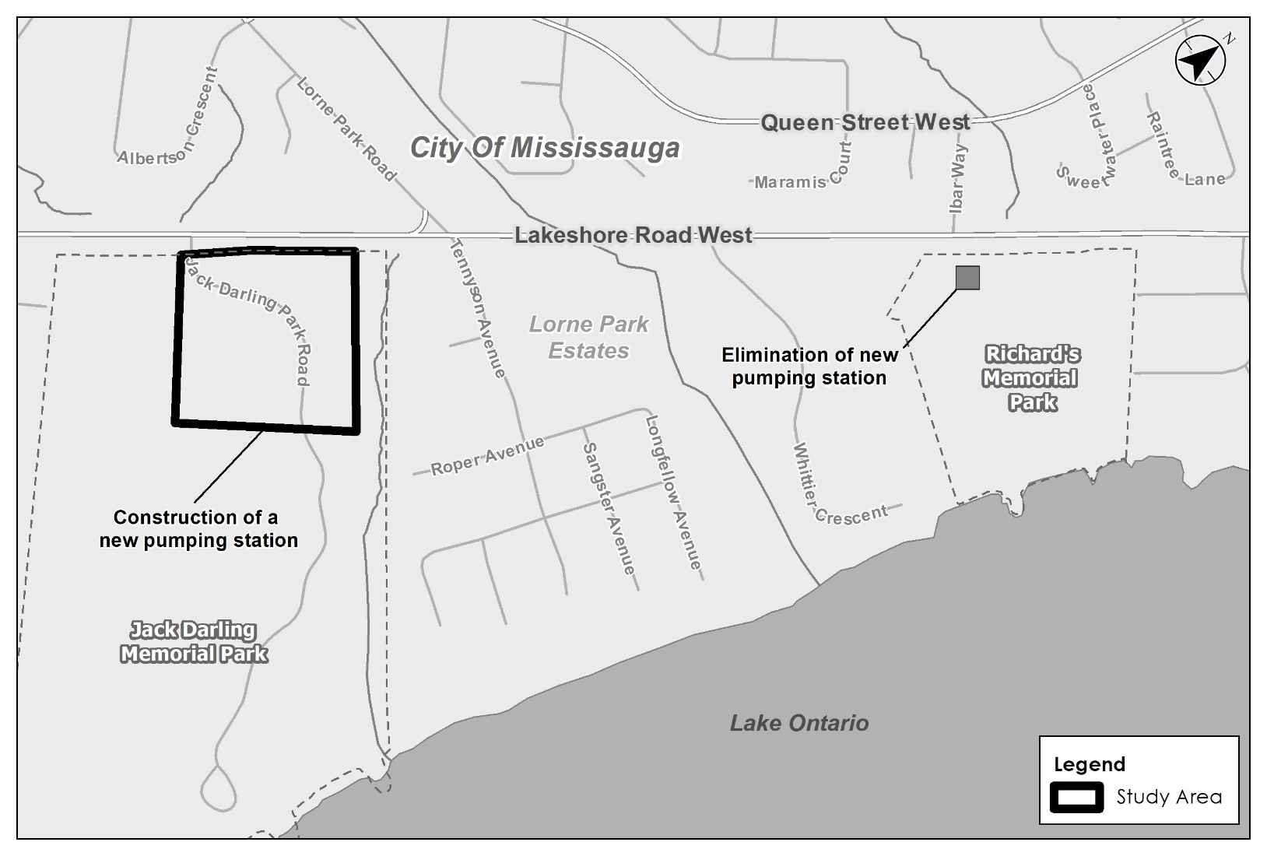
Feasibility Study & 2021 EA Addendum
Revised Strategy from 2019 Municipal Class Environmental Assessment
3

Slide 4
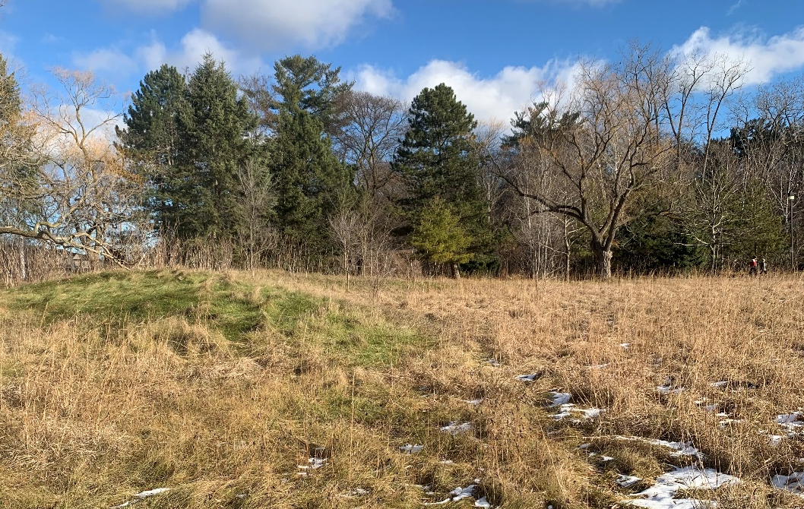
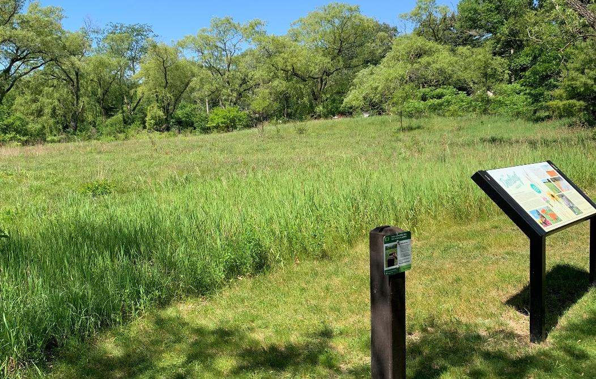
Jack Darling Memorial Park Pumping Station
Constructing an upgraded pumping station at Jack Darling Memorial Park results in the following benefits over constructing at Richard’s Memorial Park:
Allows for the consolidation of Regional infrastructure
Requires only one facility and allows construction to occur in one location
Allows for the decommissioning of 2 additional pumping stations
Minimizes impacts to Richard’s Memorial Park and returns park space
4

Slide 5
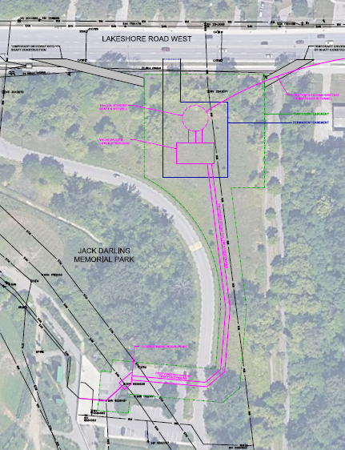
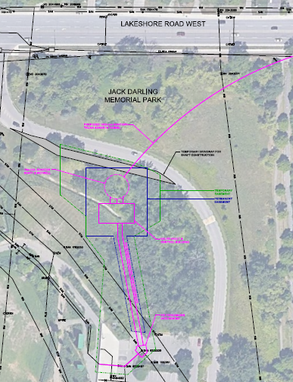
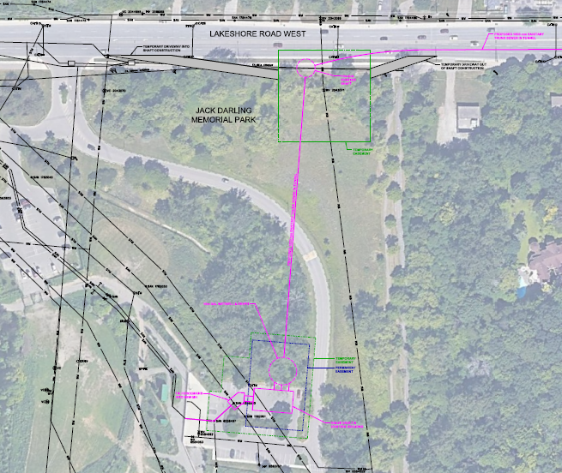
Alternative Sites at Jack Darling Memorial Park
Three (3) alternative locations for the pumping station at Jack Darling Memorial Park were developed and evaluated.
Site Option 1
Site Option 2
Site Option 3
Recommended
5

Slide 6
Preferred Location – Site Option 3
The Alternatives Sites were assessed using the following evaluation criteria:
Technical Considerations
Environmental Considerations
Socio-Economic Environment
Cultural Environment
Financial Considerations
Site Option 3 was selected as the preferred location for the following reasons:
Reduces multiple impacts to the park and local community by allowing for tunnel and station construction at the same time
Avoids a portion of the mixed tall grass prairie restoration area at the northeast corner of the park boundary, which is dominated by native plant species. Temporary impacts to this area are anticipated, and a rehabilitation plan will be prepared to re-naturalize the area and retain the ecological function of the natural heritage features
Avoids impacts to existing dog park and focuses impact on the paved parking lot area
Clusters the existing JD1 facility and the new station closer together providing for potential shared infrastructure as well as operational advantages
Follows similar alignment to the preferred alignment from the 2019 EA and reduces the need for additional field studies (i.e., archaeological assessment, etc.)
6

Slide 7
Summary of Recommendations
The overall Preferred Solution for the Front Street Wastewater Pumping Station Wastewater Diversion Class EA as a result of the Feasibility Study and EA Addendum includes the following:
Elimination of the new pumping station identified at Richard’s Memorial Park
Construction of a new pumping station at Jack Darling Memorial Park
EA Addendum Process
An Addendum Report to the 2019 Class EA Study will be prepared for public and agency review
A “Notice of Filing Addendum” will be sent to the project contact list to notify of the 30-day review period
Interested persons may provide written comments to our project team
Only changes from the 2019 Class EA Study, noted above, are open for review and comment
8

Slide 8
Contact the Project Team
Review input and confirm recommended solution
Filing of Addendum
Winter 2022
Design
Now - 2024
Construction
2024 - 2026
We are here!
If you would like to provide comment, or discuss further, please contact one of the following study team members by DATE, 2021:
Lyle LeDrew, C.E.T Project Manager, Engineering Wastewater Collection Region of Peel 905-791-7800 ext. 7836 Lyle.LeDrew@peelregion.ca | David Abreu, P.Eng. Project Manager, Water Division Region of Peel 416-274-9164 David.Abreu@peelregion.ca | Neil Harvey, P.Eng., PMP Consultant Project Manager Stantec Consulting Ltd. 905-381-3234 Neil.Harvey@stantec.com
9

