Slide 1
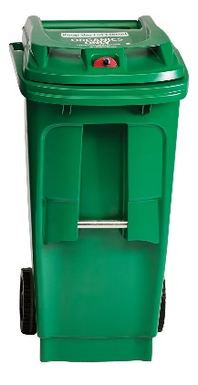
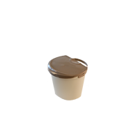
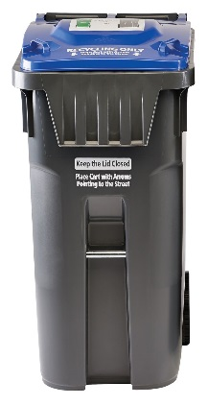
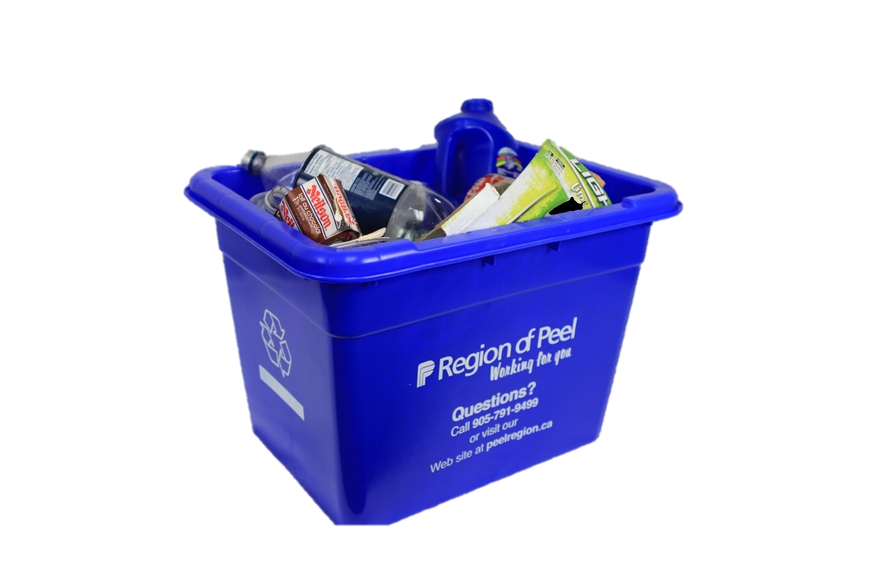
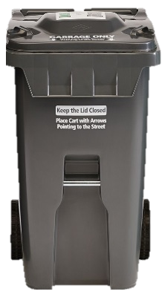
Waste Sorting ideas
Virtual Waste Sorting
  Region of Peel’s Waste Sorting Game
  Slide show
Interactive Waste Sorting
  Waste Sorting with items
  Get Moving Sorting Game
  Sort Your Lunch
Notes:
Teacher Notes:
Select a sorting activity from below to teach students about sorting garbage, recycling, and green bin:
Virtual Waste Sorting
Option A - Region of Peel’s Waste Sorting Game (Online)
Allow students to do Waste Sorting on their own at home; and/or encourage doing the Waste Sorting Game together as a class.
Interactive Waste Sorting
Option A - Waste Sorting using Actions
Continue by clicking through slideshow. Ask students to do actions to show where they think the waste item goes:
Garbage: Plug their nose and say “Peeyew”, wave hand in front of face
Recycling: Roll their fists around each other again and again
Organics: Pretend to bite an apple
Option B - Get Moving Sorting Game
Activity can be done outside, gymnasium, or an open area that allows for movement
Designate a corner or specific location for each type of waste, garbage, recycling, organics
Call out and/or show students different waste items
Ask students to walk/run to the corner in which they think the items gets disposed
Option C - Sort Your Lunch
Ask students to hold onto any waste they made during snack or lunch time.
One by one, ask students to identify their waste item and assist them to sort their waste using the garbage and recycling bins at school

Slide 2
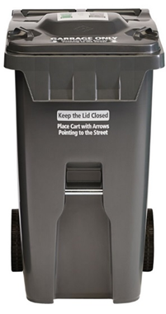
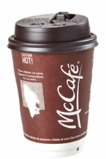
Where does it go?
Notes:
Take out coffee cups should be placed in the garbage

Slide 3

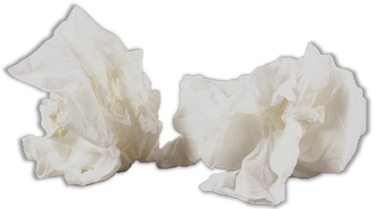
Where does it go?
Notes:
At Home: Tissues belong in the Green Bin
At School: Tissues belong in the Garbage

Slide 4
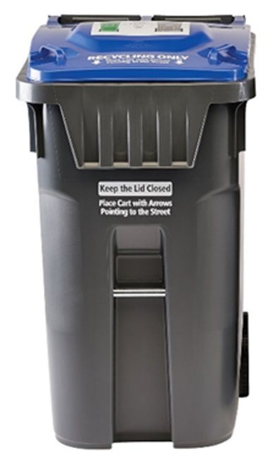
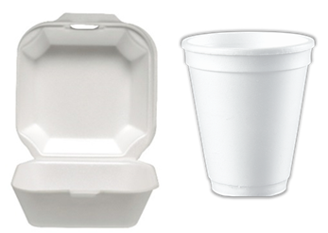
Where does it go?
Notes:
Styrofoam belongs in the Recycling so long as it is clean of any food.

Slide 5

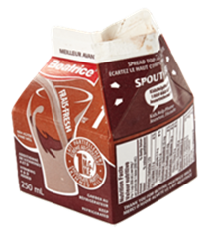

Where does it go?
Notes:
Milk cartons belong in the recycling once all the liquid inside is drained.

Slide 6

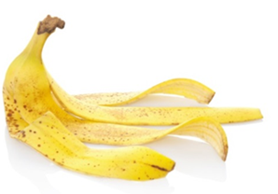

Where does it go?
Notes:
Teacher Notes:
Discuss the differences between food waste (full banana) and food scraps (banana peel)
At Home: Banana Peel= Green Bin
At School: Banana Peel = Garbage

Slide 7
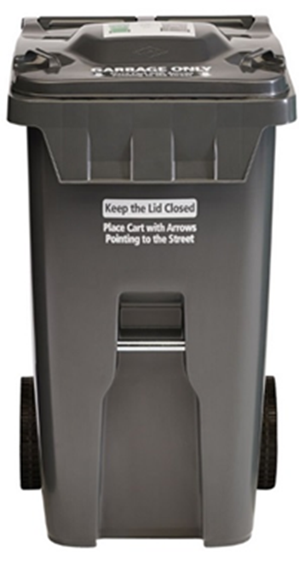
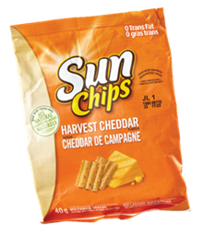

Where does it go?

Slide 8
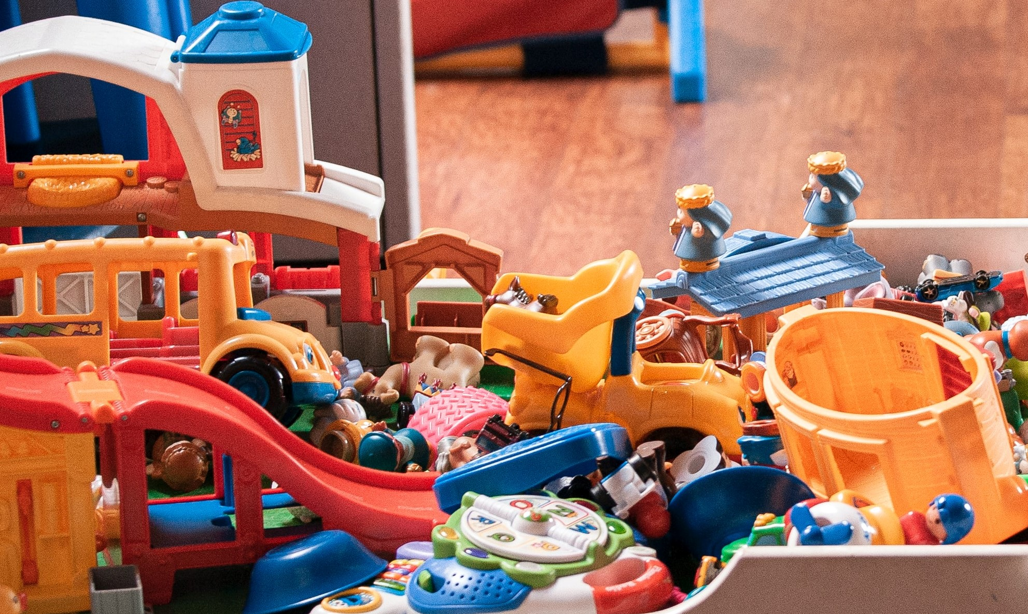
Where does it go?
Notes:
Toys can be sent to a Community Recycling Centre for donations or disposal.

Slide 9
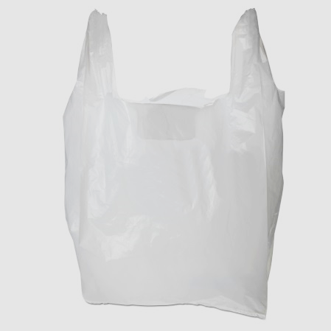
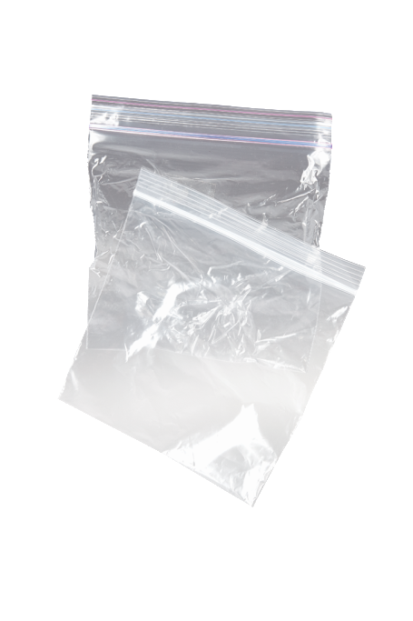

Where does it go?
Notes:
Plastic grocery bags tied into one bag can go into the recycling. Plastic grocery bags filled with other recyclable materials like paper and bottles must be put into the recycling bin loosely (not tied up).

Slide 10
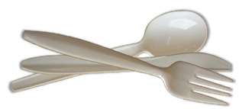

Where does it go?
Notes:
Plastic cutlery belongs in the garbage.

Slide 11
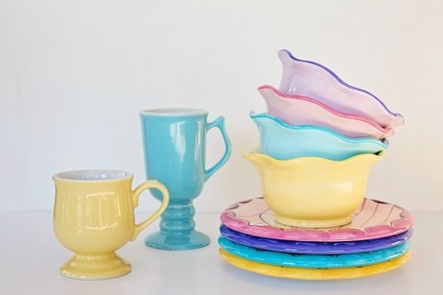
Where does it go?
Notes:
Ceramics, like plates and mugs can be taken to a Community Recycling Centre for donation or disposal.

Slide 12
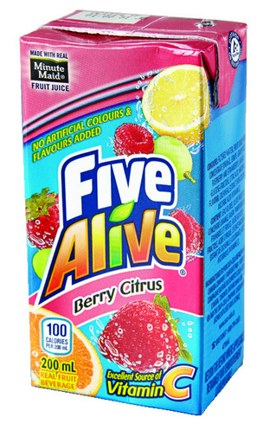
Where does it go?
Notes:
Teacher Notes:
Remind students that the straw must go in the garbage
Juice box must be empty before putting in the recycling

Slide 13
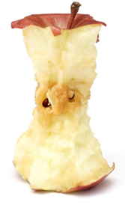

Where does it go?
Notes:
Teacher Notes:
At Home: Apple Core= Green Bin
At School: Apple Core= Garbage

Slide 14
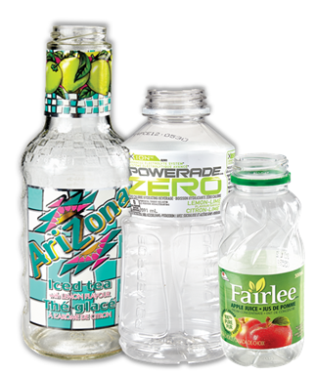
Where does it go?
Notes:
Teacher Notes:
Note that the caps have all be taken off and go into the garbage.

Slide 15
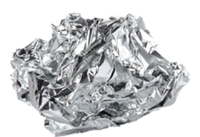
Where does it go?

Slide 16
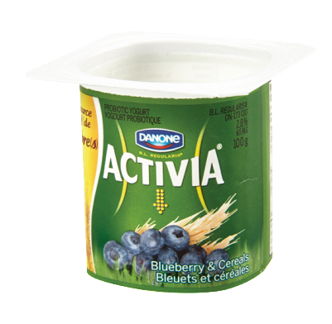
Where does it go?
Notes:
Teacher Notes:
Note that the caps and lids have all be taken off and go into the garbage.

Slide 17
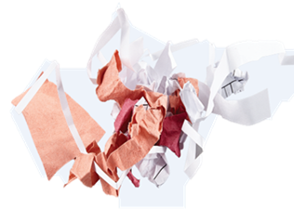
Where does it go?
Notes:
Teacher Notes:
At Home: Paper Scraps = Green Bin
At School: Paper Scraps = Garbage

Slide 18
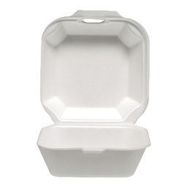
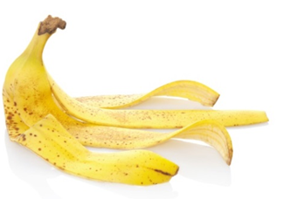
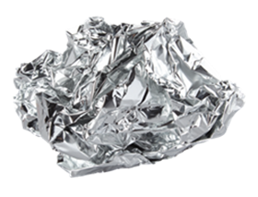
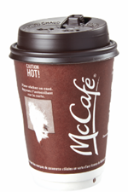
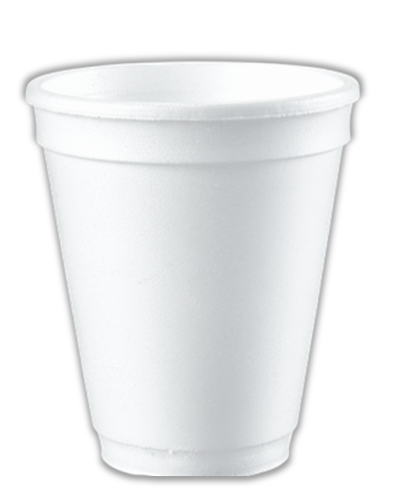
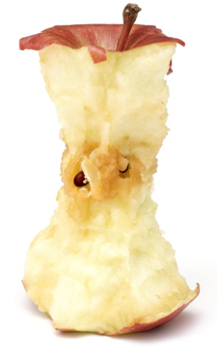
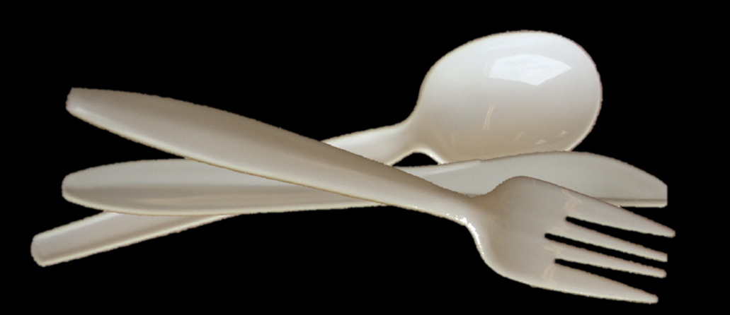
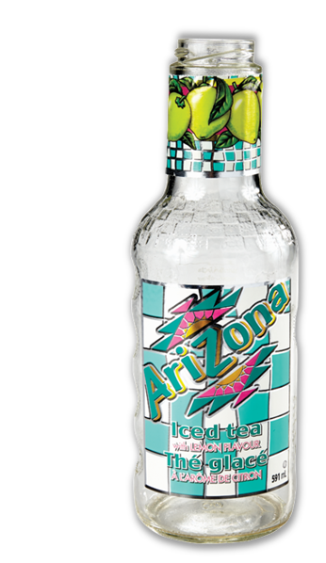
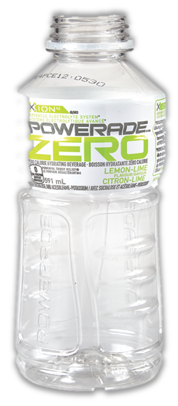

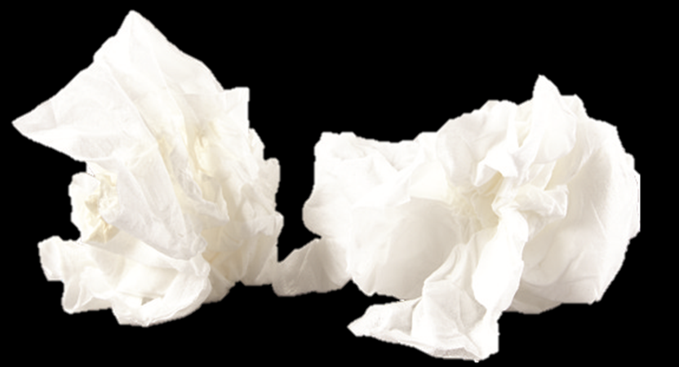
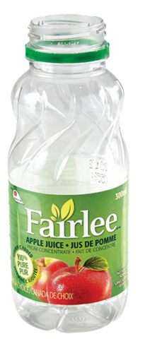
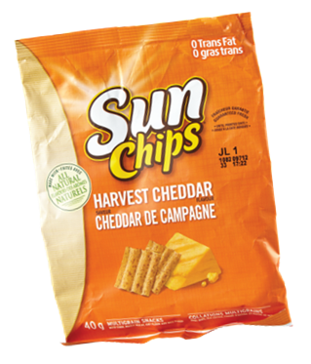
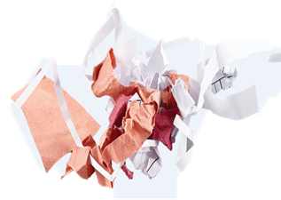
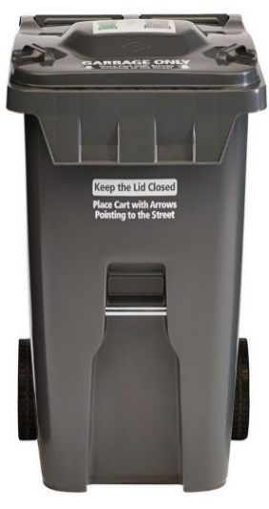


Notes:
Teacher Notes:
“Great job everyone! This is what it looks like when we properly sort all of our waste!”

