Slide 1

Water Treatment
In the Region of Peel
Environmental Education
Website: peelregion.ca/enviroed

Slide 2


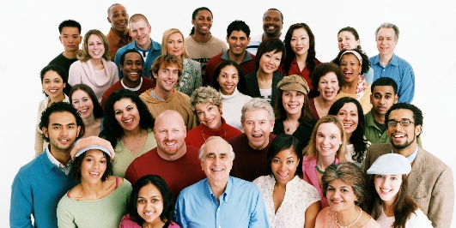

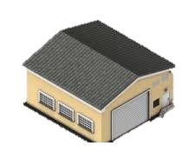
P
E
E
L
Town of Caledon
City of Brampton
City of Mississauga
This Photo by Unknown Author is licensed under CC BY-NC
2 water treatment plants
Arthur P. Kennedy & Lorne Park
1.51 million
residents
3 wastewater
treatment plants
GE Booth, Clarkson & Inglewood
15 wells
(Municipal)
Notes:
Teacher Note:
(Click-2) Region of Peel includes the Town of Caledon and 2 cities – City of Brampton and City of Mississauga
The Region of Peel is a level of municipal government and some of the programs and services that the Region of Peel provides to our communities includes:
Recycling and Waste collections and disposal
Maintenance of regional roads, including snowploughing in the winter and paving in the summer
Health services
Ambulance services
Peel Regional Police and services and
Peel Region also provides you with clean, safe drinking water and wastewater treatment
(Click-3) Peel has a population of 1.51 million people, who make up this vibrant community where people live, work and play
Town of Caledon’s population is 86,000 people
City of Brampton’s population is 676,000 people
City of Mississauga’s population is 748,000 people
(Click-4) Region of Peel has 2 water treatment plants, in Mississauga and (Click-5) 3 wastewater treatment plants, 2 for South Peel and 1 in Inglewood, and (Click-6) 15 municipal wells that treat water that we use daily
Most of these plants are located in Mississauga, close to Lake Ontario as it allows the Region to treat and clean water faster and more efficiently
Discussion Questions:
Think about how we use water in our every day lives

Slide 3
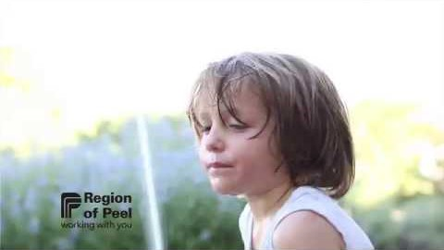
Investing in our Water
Notes:
Teacher Note:
Watch video: ‘Investing in our Water’
https://www.youtube.com/watch?v=XMr0JqGOX0A
To play video
Press the Play button
Share information from the video – have students share interesting facts they heard from the video
Did you know?
Did you know that we have over 200 staff in the Region of Peel who treat and maintain our water to make sure every time you turn on the tap, the water is fresh and healthy to drink?
And every time you flush your toilets, or take a bath, these dedicated staff also work to make sure that dirty water gets cleaned before putting it back to the lake
They work to make sure all our water gets treated for everyone, 1.51 million people living and working in Peel
Every day the Region of Peel treats 570 million litres of water
That’s enough to fill 228 Olympic sized swimming pools

Slide 4
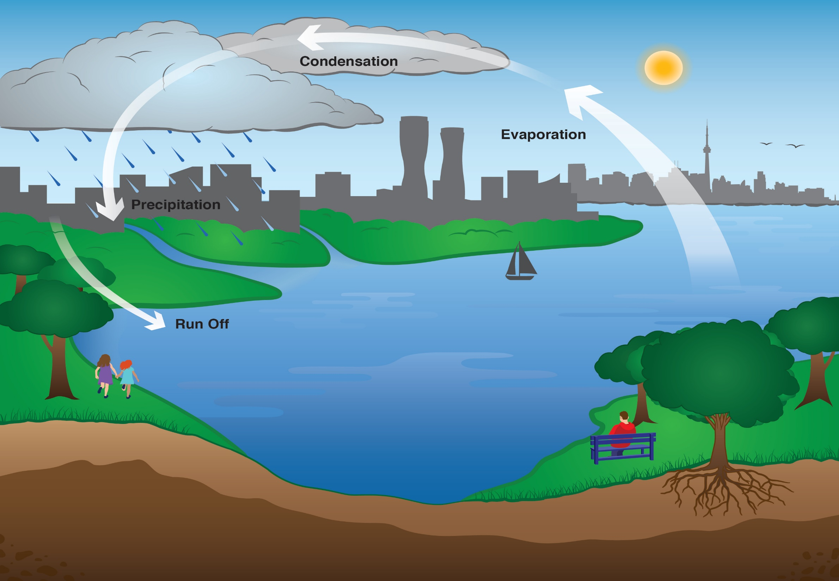
Sun
Condensation
Evaporation
Precipitation
THE WATER CYCLE
Runoff
Lake Ontario
Notes:
Teacher Note:
Review the water cycle with students
Where do we in the Region of Peel get our water from?
Brampton, Mississauga and Bolton get water from the Lake. Other people who live in Caledon get water from wells, either on their own property, or municipal wells that are owned by the Region
Water from Lake Ontario is fresh, which means that the water is not salty like the water in oceans and seas
The water cycle is a continuous circulation of water from rivers, lakes and oceans into the atmosphere onto the land and back
(CLICK-1) Sun: the source of energy that drives the whole cycle
(CLICK-2) Lake Ontario: this is our water source
(CLICK-3) Evaporation: the sun heats up the water in lakes, rivers and oceans and turns it onto vapour
(CLICK-4) Condensation: water vapour in the air gets cold and changes back into liquid form
(CLICK-5) Precipitation: the clouds get heavy and water falls back to the earth in the form of rain, hail, sleet or snow
(CLICK-6) Runoff: moves water across land and makes its way to the nearest body of water such as a lake

Slide 5
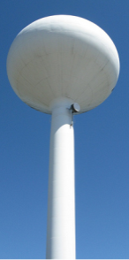
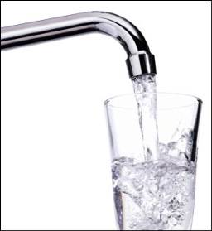
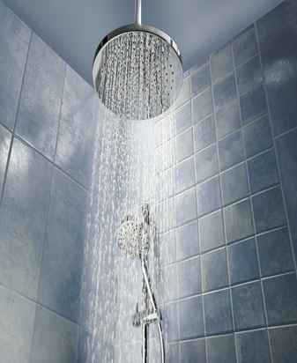
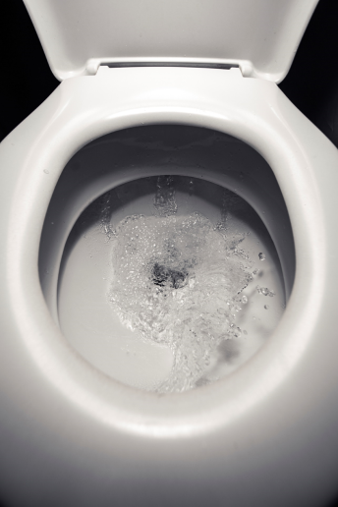
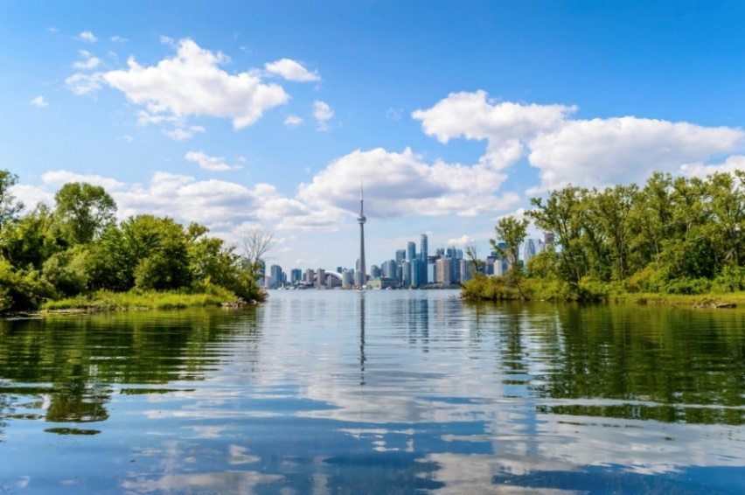
HUMAN WATER CYCLE
Water Treatment Plant
Wastewater Treatment Plant
Notes:
Teacher Note:
(Click-1) Has anyone ever heard about the human water cycle? What could this be all about?
Have students share their thoughts
What happens when we use water to brush our teeth, shower, go the bathroom – where does it go?
(Click-2) Do we send it directly to the Lake?
Answer: NO
If I was thirsty, can I go down to Lake Ontario and take a cup of water directly from the lake and drink it?
Answer: NO
Why not? (have students share their thoughts)
(Click 3) The water in Lake Ontario might have bacteria, viruses, and germs in it. All those things could make us very sick if not treated.
(Click 4+5) That is why we must send the water to get treated so it can be cleaned and made safe for us to drink. The dirty water travels through underground pipes and gets treated again at our wastewater plant before we return it back to Lake Ontario
The next few slides will cover how we treat water and wastewater

Slide 6
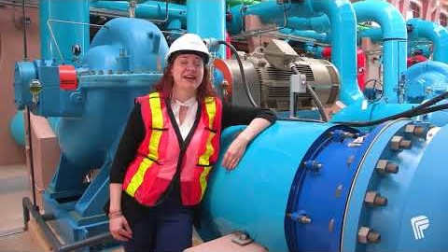
Peel’s tap water from the Arthur P. Kennedy water treatment plant
Notes:
Teacher Note:
This short video will show footage of the Arthur P. Kennedy water treatment plant
Watch video: ‘Peel’s tap water from the Arthur P. Kennedy water treatment plant’
https://www.youtube.com/watch?v=J9wY-qMrqZg
To play video, click the Play button
Before watching the short video, discuss with students
What is the purpose of a water treatment plant?
Did you know?
That Arthur P. Kennedy Plant can treat up to 1.2 billion litres per day
Every day the Region of Peel treats 570 million litres per day
In the year, 2041 another 21 years from now, it is estimated that almost 2 million people will live in Peel. That means we will have to continue treating water for even more people in Peel, a task that the Region takes great pride in doing.
Discussion Questions:
Do you think the Region of Peel can treat water for 2 million people?
Explain your reasoning?
Answer: Yes, the Region of Peel can treat up to 1.2 billion litres per day. There’s always room for more capacity to treat water per day. Forecasting for future population growth is something that the Region of Peel plans for
Region of Peel is committed to providing safe and reliable drinking water to everyone

Slide 7
13
1
2
3
7
12
5
4
6
9
8
10
11
Notes:
Optional Slide*
Teacher Note:
Reviewing Water Treatment
We have provided a PDF copy of this schematic for your reference as well – it can be used throughout the lesson
Go over the stages of water treatment:
(Click-1) 1. Water source is Lake Ontario: A large intake pipe extends 2km out into Lake Ontario. The intake pipe is so big, you could drive an SUV inside it. This is how we get water from the Lake to get treated.
(Click-2) 2. Travelling Screens: Large rotating mechanical screens remove materials such as branches, fish, garbage, and zebra mussels
(Click-3) 3. Low Lift Pumps: brings water into the facility from the Lake to begin the stages of treating water
(Click-4) 4. Liquid Oxygen: Ozone is used to disinfect the water. Ozone gas is unstable and therefore cannot be transported, so Ozone is generated on site from liquid oxygen and electricity
(Click-5) 5. Ozone Generator: we use a process called electrolysis to convert O₂ to O₃ where an electrical current is passed through the oxygen to create ozone gas.
(Click-6) 6. Ozone Contactors: The ozone is bubbled through the water in ozone contactors. Ozone kills the bacteria and breaks down large particles
(Click-7) 7. BACC – Biologically Activated Carbon: after ozone, the water passes through the BACC. Here removal of organic materials from water takes place
(Click-8) 8. UV – Ultraviolet Light: is where filtered water passes through a lighting unit which uses the UV rays to inactivate microorganisms like bacteria, so they can’t make people sick, or be able to reproduce their DNA
(Click-9) 9. Membrane Filters: is an ultra-filtration membrane system. During this stage, removal of small particles and microorganisms takes place
(Click-10) 10. Weir Chamber: Filtered water is directed to the weir box where water is stored and is also the location where chlorine and fluoride are added. Chlorine is used to disinfect bacteria and Fluoride is added for dental health
(Click-11) 11. Storage Reservoir: treated water flows by gravity into the water storage reservoirs
(Click-12) 12. High Lift Pumps: treated water leaves the reservoir by way of high lift pumps and enters the distribution system.
(Click-13) 13. Distribution System: before treated water reaches our homes, schools and businesses in Peel, water is sampled from various stages of the treatment process. Water is sampled 4 times a day, for over 150 parameters and sent to an independent laboratory for testing. These laboratories must be certified by the Ministry of Environment. Treated water flows by gravity into the water storage reservoir. Total time for water treatment is 2-3 hours.

Slide 8
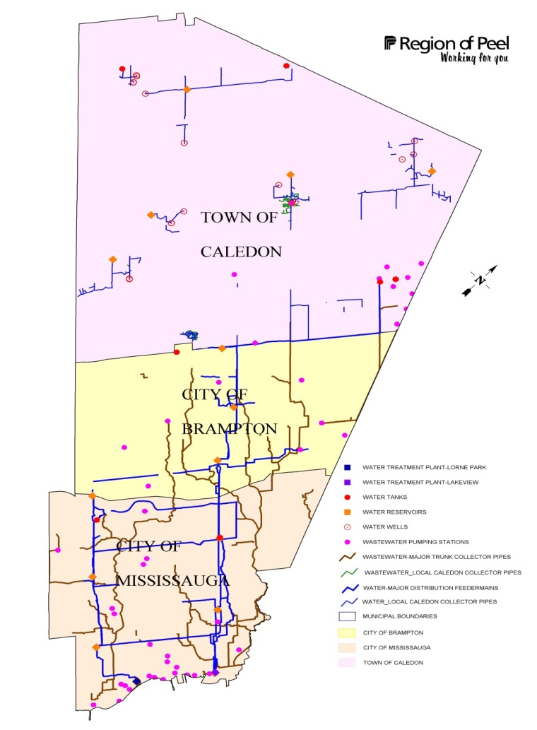

How water gets to our schools, homes and businesses
Lake Ontario
Notes:
Teacher Note:
Blue lines = represent treated water moving from the water treatment plants to our communities
Discussion Questions:
Water needs to reach many homes, schools and businesses all across Peel. High lift pumps are used to pump it across the Region and we need them to be straight for the water pressure to reach all the way to Caledon homes, schools and businesses
What do you notice about Caledon compared to Brampton and Mississauga?
Caledon is rural, and many homes use wells for drinking water

Slide 9
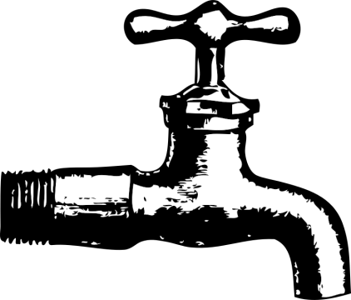

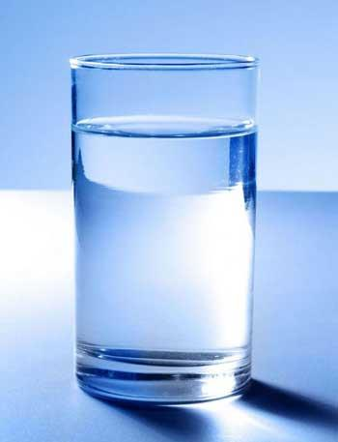
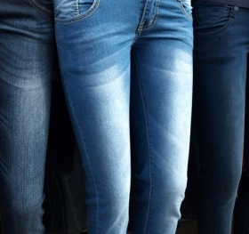
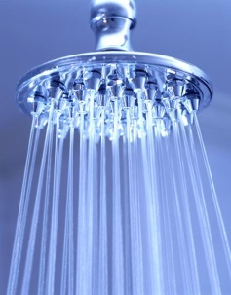
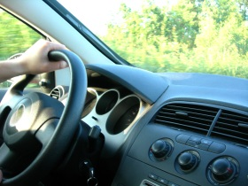
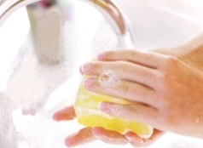
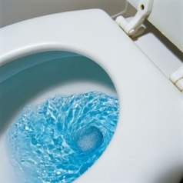

Conserving Water: Our Water Footprint
Physical Water
Virtual Water
8500 L
250 L
per day
85 L/10 min.
6400 L
per day
218 L
per day in Peel
Notes:
Teacher Note:
Water is a Finite Resource – conservation is important for future generations.
Ask students why they think water conservation is important?
Ask students some of the ways they think they use water? The responses are likely to fall under the physical water.
Physical Water = direct uses of water, water that we use for drinking, showering, washing hands and flushing toilets
Discuss Virtual Water Uses:
Virtual Water = non-direct uses of water, water that we can’t see, touch, taste or feel, and it makes up a big part of our water footprint
We wear water, it takes 8500L of water to make 1 pair of jeans
Furniture, houses, cars, roads, all these things we build, also needs water
We also spend money on generating electricity so every time we charge our phones or watching TV we are using water
Farming uses huge amounts of water and
Many other uses of water that we use daily
Discussion Question:
Can anyone think of any other ways we may use water, either directly or indirectly.
Discussion Questions:
(Click-1) Can anyone guess the average water usage per Canadian?
(Click-2) The average water usage per Canadian is about 250 L per day in Canada, and 218 L per day in Peel, and this is physical water, like taking a shower, washing our hands before we eat a meal, but when we consider our virtual water usage, our average jumps to (Click-3) 6400 L per day!!!! That’s a lot of water! In fact, Canadians are among the highest consumers of water in the world!
Remember that our freshwater we have available is 1.2%. So it’s important that we conserve the water we have for future generations to be able to enjoy.
What does conserving water look or mean to you?
Think about some adjustments in your own life that you can make to help conserve our water?
Just a 10-minute shower can use up to 85 L of water
Based on the water treatment process we talked about before, what might be some reasons to conserve the water we consume?
Answer: There is a lot of energy and effort that goes into the process of making drinking water safe to drink. By conserving water, we can also conserve the energy required to clean it!
How much freshwater is available on earth?
Answer: 2.5% of the world’s water makes up freshwater
What makes up the total amount of surface water?
Answer: 1.2%
What amount of water makes up the agricultural industry?
Answer: 70%
What are some advantages and disadvantages to the biodiversity of agricultural practices on land and water? Discuss with the class
Can you describe in your own words what is virtual and physical water?

Slide 10


Remember:
Everyone plays a part in protecting and conserving our water!
Keep this in mind as we continue to the Water Treatment Plant Virtual Tour
Notes:
Teacher Note:
End of the lesson, ask students
What have they learned today about water?
Have students share their findings
Share with students that everyone including them, have a part in protecting and conserving water
Ask students to refer to the handout in preparation for the virtual tour. There are two options: teacher-led, or student self-exploration.
Refer to the Teacher Handbook for the tour outline and additional discussion points.

