Slide 1
2023 Workforce Innovation Funding (WIF) and Professional Learning Day Updates for Licensed Child Care Centres
Presented by Early Years & Child Care Services
January 27, 2023
Notes:
Nakiema
Welcome everyone. I am Nakiema Palmer, the new Director of the Early Years and Child Care Division at the Region of Peel.
Thank you all for taking the time to attend our first teleconference in 2023.
I’m very excited to be here today and to have this opportunity to work with you on initiatives that will support our workforce in as we grow to meet the demand for care of our sector. The Workforce Innovation Funding is one of them.
You are all critical partners in making child care more accessible and affordable for families in Peel by sharing feedback, experiences, and recommendations.
I value and respect your unique strengths, expertise, and knowledge as we work together to support Peel’s early years and child care system transformation.

Slide 2
Housekeeping Items
This meeting is being recorded and will be shared with the presentation.
Your microphone will be muted unless called upon during the Question period.
You can participate by using the chat function to raise any questions you have.
You can also email us at earlyyearssystemdivision@peelregion.ca or contact your Early Years Specialist.
The personal information collected during this meeting is collected under the authority of the Municipal Act S.O. 2001, c.25. The information will be used for future reference for purposes of the Region of Peel’s Human Services Department, Early Years and Child Care Services Division.
Questions about the collection of personal information and information collected should be directed to earlyyearssystemdivision@peelregion.ca.
Notes:
Nakiema
Before we get started, I’d like to share some housekeeping rules:
Please note we will be recording today’s teleconference. Remaining on the call implies you are providing your consent for us to record.
Please turn your cameras off and put your mics on mute;
If you have a question, you may ask your question in the chat; or type your name in the chat to ask your question verbally if you prefer
We will address your questions at the end using a sequential order
If you’ve typed your name, we will call upon you to speak to your question

Slide 3
Agenda
WIF Updates
Funding Overview
Policy and Requirements
Payments
Key Dates
Professional Learning Day Registration
Question Period
Notes:
Nakiema
We have copied the Agenda in the chat – As you can see from today’s agenda, the purpose of this teleconference is to share with you the updates made to the Workforce Innovation Funding (WIF) program for 2023 along with information on the professional learning day registration, and to give you an opportunity to ask questions.

Slide 4
2023 EYCCCS Guidelines – Centre Based
CWELCC | General Operating | WEG/HCCEG | Workforce Innovation Funding (WIF)
CWELCC Fee Reduction CWELCC Compensation Minimum Wage Offset Floor $1/hour increase Transition Operating Grant Increasing Costs Audit Administration Funding (GOF, WEG, CWELCC) Special Purpose | Staff Wages and Benefits (with Historical rolled in) Pay Equity | WEG HCCEG Administration Funding for WEG only providers | Paid Planning Time Region’s Professional Learning Day (child care fees offset and lunch and refreshments) Flexible Expenses (E.g., professional learning costs, Recruitment Costs, etc.) Administration
Notes:
Nakiema
As mentioned on the previous slide, today we will be talking about the Workforce Innovation Funding.
.
As a reminder, the WIF is a one-time funding from the province available to support attraction and retention in the child care workforce in 2022 and 2023.
WIF includes a number of eligible expenses like paid planning time, professional learning costs and paid professional learning time which respond to the input you provided in 2022 and provides you with the flexibility you need to meet your needs.
We recognize that this is a new program so it may be challenging to understand and hope that today’s session will be helpful. As always, you can continue to access support through emailing ZZG or contacting your EYS.
I will now turn it over to Kaysee who will walk us through the WIF updates and the professional learning day registration items.

Slide 5
WIF Updates
Notes:
Kaysee
Workforce Innovating Funding, or WIF, is funded through the one-time workforce funding from the province available in 2022 and 2023.

Slide 6
WIF Funding Overview
To pilot eligible innovative ideas to attract and retain the child care workforce.
child care fees and lunch and refreshments for the Region’s professional learning day – mandatory
paid planning time – mandatory
professional learning costs
paid professional learning time
credential evaluation for internationally trained staff
recruitment costs
Notes:
Kaysee
What can you use WIF funding for……. Under the funding, there are a number of eligible expenses – some of them are "mandatory" and some of them are "flexible"
The mandatory expenses are a must – meaning you must use part of your WIF funded to address the requirements of those expenses. In 2023, we have 3 mandatory expenses – using WIF to cover the parent fees that will not be charged on the day of the region's PL Day, paying for lunch for participants in the learning day and planning time.
I will speak more about the fee offset for the regions learning day in just a moment.
Planning time was also a mandatory expense in 2022.
PL Learning costs, paid professional learning time, credential evaluation remain the same as 2022.
Recruitment Costs – this year is covered through WIF, not COVID -19 funding as in 2022
The eligible expenses were chosen based on the priorities identified in the professional learning and workforce survey the Peel did in early 2022.

Slide 7
New! Supports for the Region-wide professional learning day on Feb 17, 2023
You must use your WIF to:
Offset child care fees for the day
don’t charge fees and use WIF to cover the portion of the fees not already covered by CWELCC (as applicable)
mark “N” on the child care subsidy attendance of children
pay staff who attend the event. No staff should lose pay for participating.
Provide lunch and refreshments to participating staff, up to a max of $30/per staff.
Notes:
Kaysee
What’s new in the guideline
No staff should lose pay for participating in the Region's PL Day, what this means...
You take the fees that would have been charged on February 17, 2023 if you were open, and use fee offset funding to replace the revenue for the children typically enrolled on a PD Day/Friday. Fee offset funding includes CWELCC and/or WIF. This means that if staff typically worked more than 6 hours on a PD Day, and their salary was covered by the fee on February 17, then they should be paid for the hours they typically work on that day.
If you incur salary and mandatory benefit expenses on February 17 that are not typically covered by your fees – for example for staff who are participating in the learning day who do not typically work 6 hours on Fridays/PD Days or do not work at all on Friday/PD Days, you may charge this against the “paid professional learning time” expense in WIF as the salaries for the extra hours worked are covered under this expense.

Slide 8
Other updates
Requirement to pay WEG and GOF for WIF supported hours (as applicable).

Slide 9
2023 WIF Payments
You will receive your 2023 WIF payment in early February (except for administration). We increased your budget in three budget categories:
child care fees (to offset child care fees for the professional learning day)
planning time; and
other (increased amount)
Tip! WIF is a multi-year announcement. Your budget was increased and includes both your 2022 and 2023 payments.
Your WIF administration funding will be issued in March and will be flowed through your CWELCC Transitional Operating Grant (TOG).
If you opted-out of CWELCC, you will get your WIF administration funding through GOF.
Notes:
Kaysee
For this funding, we have tried a multi-year announcement and funding.
We increased your budget in gov grants in three categories.
We will take the time to explain how it is working in 2023.
Payment generated in February – this is 2023 payment.
In 2023, the funding will flow under a few budget categories.

Slide 10
Key 2023 WIF Dates
Date | Description
Week of Feb. 1, 2023 | 2023 WIF payment issued We will increase your WIF budget and issue your 2023 WIF payment.
February 17, 2023 | Region-wide professional learning day System participates in the professional learning day.
March 10, 2023 | Interim 2022 WIF reconciliation due Submit your complete interim reconciliation. As a reminder, your 2022 payment was to be used by December 31, 2022. Unused 2022 funding cannot be used in 2023. Complete the reconciliation directly in GovGrants. An Excel reconciliation template is not required.
Spring 2023 | WIF evaluation approach We will share our WIF evaluation approach. We want to hear from you, your staff about what is and isn’t working so that we can maximize the impact of funding and improve our recruitment and retention funding supports.
December 31, 2023 | Deadline to spend 2023 WIF Use your 2023 WIF payment by this date.
TBC | Final WIF reconciliation due to Region Submit your complete final reconciliation.

Slide 11
Professional Learning Day Registration

Slide 12
Registration is Now Open
Refer to memo sent on January 23 for more details
1. Register
Jan 30 (early bird)
Feb 10 (closes)
3. Access Event Site
Starting Feb 13
4. Enjoy the Day
Feb 17
2. Registration Confirmed
Feb 13
Notes:
- On this slide is just a high level overview.
- A copy of the memo you received includes detailed resources to support registration and participation in the day
1.Register
Complete Survey Monkey Form
Upload Group Form, if required
Choose this option if you would like to register home visitors and home child care providers on your behalf or if home visitors and home child care providers do not have or wish to provide their email
Add team or individual picture (optional)
Submit via Survey Monkey
Early bird registration is Jan 30
Deadline is Feb 10
2. Registration Confirmed
You will receive an email with link to event site on February 13, 2023.
With this link you can access the event portal before, during and after the event.
3. Access Event Site
Click link in confirmation email starting Feb 13
Enter email address you provided at registration
Check it out prior to the event to access event details, resources and test your IT!
4. Enjoy the Day
Log in as of 8:45 am
Access breakout sessions
Use chat box to share your thoughts
Use question box to send us your questions
Access wellness and learning resources.

Slide 13
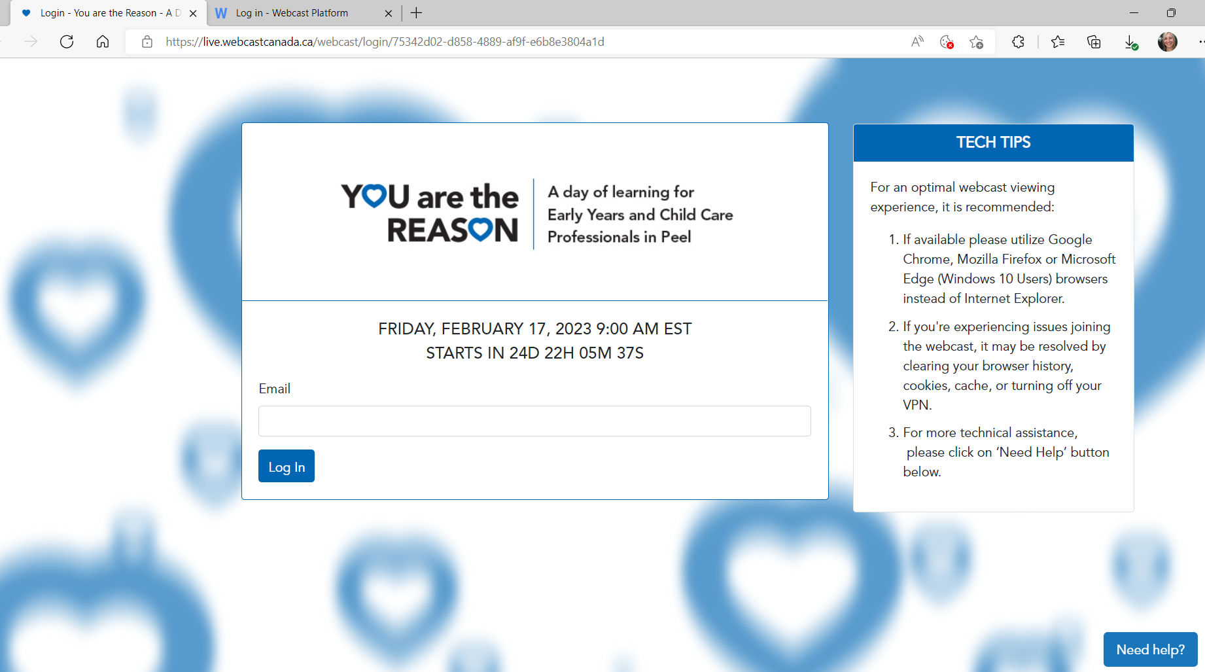
Log-in to Event Site
Link from confirmation email
Email that you registered with
Important:
If you cannot find your confirmation email after February 13, email us!
Notes:
After Feb 13 – check junk./spam mail for confirmation email

Slide 14
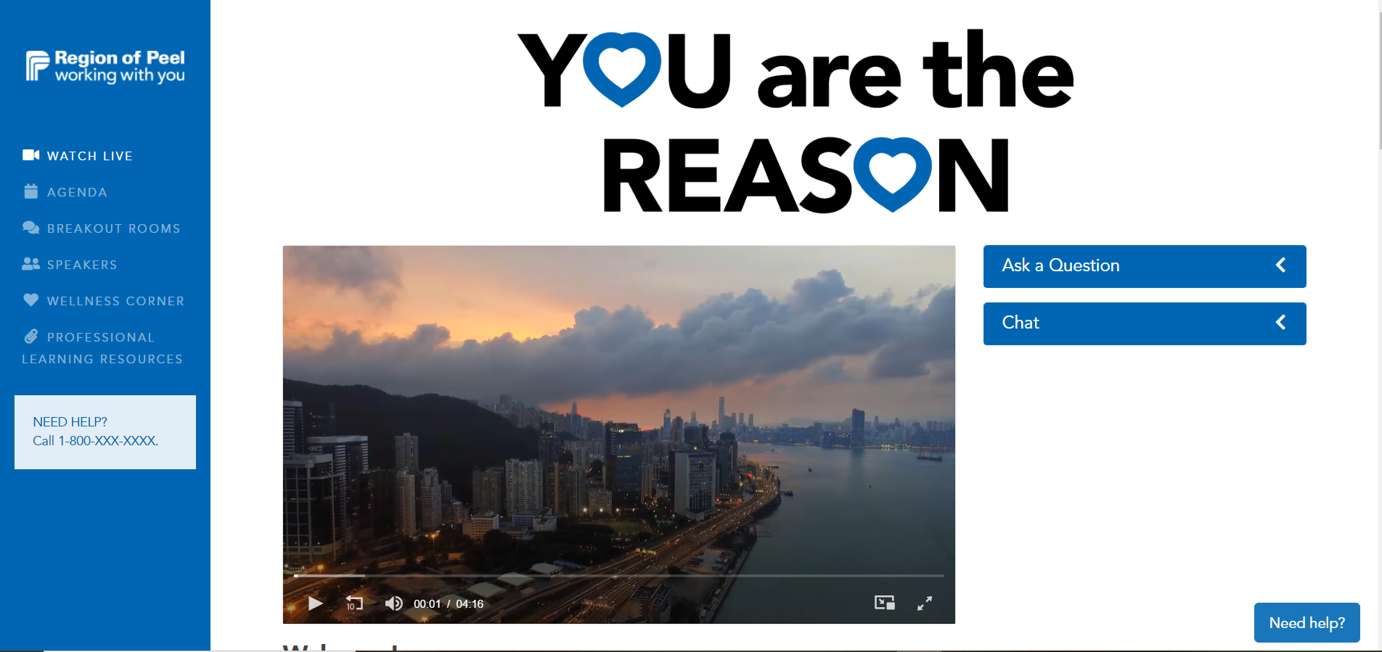
Event Site
Links to pages with more information
You can access your breakout session by either selecting Breakout Rooms from this menu bar or from a link provided on the Agenda page.
Questions submitted are only seen by the event staff and speakers
Post/see
comments in the chat from all event participants.
Main Activity

Slide 15
Important Reminders
Register emails for all individuals who would like access to the event site before, during and/or after the event.
Store confirmation emails where they can be easily accessed on February 17.
Breakout sessions – choice #1 is where you go unless you hear otherwise from us.
IT & Connecting (review TIP sheet prior to event):
You need Zoom on each device you are using the day of the event.
IT help will be available the day of the event.
Encourage staff to complete post-event survey for the day – we need your feedback!
Notes:
Reminder:
If you haven’t already done so, we kindly ask for 10 minutes of your time to complete the Mentoring Program Survey. We have extended the deadline to January 31, 2023. An invitation to complete this survey was sent to you on January 5, 2023.
Your input is valuable as we develop with the support of our consultant, Jennifer Kirkham with Mischievous Cat Productions. Mentoring Programs/Onboarding Toolkits for our sector which have shown to support recruitment and retention.
Copy and paste the following into the chat:
https://www.surveymonkey.com/r/Mentoring_LicensedCentreBased
Now I want to pass it along to Sam who will facilitate the question period.

Slide 16
Questions?
Notes:
Sam
Thanks Kaysee
We will now take questions – we will start by the questions that were submitted by email and then go in sequential order from the chat.
Olivia or Sonia to facilitate questions depending on topic

Slide 17
Have more questions?
Please email us at earlyyearssystemdivision@peelregion.ca or contact your Early Years Specialist.
Notes:
SAM
You may email EarlyYearsSystemDivision@peelregion.ca or contact your EYS for any additional questions.

Slide 18
Thank You!
Notes:
Sam
Thank you all for taking the time to attend today’s session. We hope that this information regarding the Region’s 2023 WIF has been helpful.
Option 1- Non- profit teleconference (morning)
As a reminder, our next teleconferences will be on February 15, to discuss TOG and the Expansion Strategy and 23 to go over the Workforce Compensation Funding. Please hold the dates. We value you and your feedback and are counting on your attendance.
Option - For- profit teleconference (afternoon)
As a reminder, our next teleconferences will be on February 16 to discuss TOG and the Expansion Strategy and 23 to go over the Workforce Compensation Funding. Please hold the dates. We value you and your feedback and are counting on your attendance.

Slide 19
Appendix A: WIF Budget Periods
Eligible Period | You may use WIF to cover the following eligible expenses
Jan. 1, 2022, to Dec. 31, 2022 | Professional learning costs Paid professional learning time Credential evaluation and translation
Oct. 3, 2022, to Dec. 31, 2022 | Paid planning time - mandatory
Jan 1, 2023, to at least Jun. 30, 2023 | Paid planning time
Jan. 1, 2023, to Dec. 31, 2023 | Professional learning costs Paid professional learning time Credential evaluation and translation Recruitment costs Child care fees for Region’s professional learning day (February 17) - mandatory Lunch and refreshments - mandatory
October 2022 payment
To be spent by December 31, 2022
February 2023 payment
To be spent by December 31, 2023

Slide 20
Appendix B: Examples - Offsetting child care fees for professional learning day
Agency Participating in CWELCC | Age Group | Daily fee | CWELCC covers | WIF covers | Parent payment for Feb. 17
Yes | Infant (enrolled M-F) | $100 | $52.75 | $47.25 | $0
Yes | Infant (enrolled M-F) | $100 | $52.75 | $0 | $47.25
Yes | Infant (PT Monday and Tuesday only) | $110 | N/A | N/A | N/A
Yes | Infant (PT Thursday and Friday) | $110 | $58 | $52 (PL day is a Friday) | $0
Yes | Primary and Junior school-age enrolled to attend full day on PL days (not eligible for CWELCC) | $60 (PL day) | N/A | $60 | $0
No | Preschool | $50 | N/A | $50 | $0

