Slide 1
2023 Workforce Innovation Funding (WIF) and Professional Learning Day Updates for Licensed Home Child Care Agencies
Presented by Early Years & Child Care Services
January 26, 2023
Notes:
Kaysee
Welcome everyone. I really appreciate you taking the time to attend our first teleconference in 2023.

Slide 2
Housekeeping Items
This meeting is being recorded and will be shared with the presentation.
Your microphone will be muted unless called upon during the Question period.
You can participate by using the chat function to raise any questions you have.
You can also email us at earlyyearssystemdivision@peelregion.ca or contact your Early Years Specialist.
The personal information collected during this meeting is collected under the authority of the Municipal Act S.O. 2001, c.25. The information will be used for future reference for purposes of the Region of Peel’s Human Services Department, Early Years and Child Care Services Division.
Questions about the collection of personal information and information collected should be directed to earlyyearssystemdivision@peelregion.ca.
Notes:
Kaysee
Before we get started, I’d like to start with some housekeeping rules:
Please note we will be recording today’s teleconference. Remaining on the call implies you are providing your consent for us to record.
Please turn your cameras off and put your mics on mute;
If you have a question, you may ask your question in the chat; or type your name in the chat to ask your question verbally if you prefer
We will address your questions at the end using a sequential order
If you’ve typed your name, we will call upon you to speak to your question

Slide 3
Agenda
WIF Updates
Funding Overview
Policy and Requirements
Payments
Key Dates
Professional Learning Day Registration
Question Period
Notes:
Kaysee
We have copied the Agenda in the chat – the purpose of today’s teleconference is to share with you the updates made to the Workforce Innovation Funding (WIF) program for 2023 along with information on the pl day registration, and to give you an opportunity to ask questions.

Slide 4
2023 EYCCCS Guidelines – LHCC Agencies
CWELCC Fee Reduction and Workforce Guideline | LHCC Base Funding Guideline | WEG/HCCEG | Workforce Innovation Funding Guideline
CWELCC Fee Reduction CWELCC Compensation Minimum Wage Offset Floor $1/hour increase Transition Operating Grant (if Agency does not have FSA with Peel) | FROG Payment to Providers Staff Wages and Benefits (with Historical rolled in) Pay Equity Administration/ Operating Special Purpose Transition Operating Grant for agencies with CWELCC + FSA with Peel | WEG HCCEG | Planning Time Grants Region’s Professional Learning Day (child care fees offset and lunch, refreshments, location costs) Flexible Expenses (E.g., Credential Evaluation and Document Translation, Recruitment Costs, start-up incentives and grants) Administration
Notes:
Kaysee
As mentioned on the previous slide, today we will be talking about the Workforce Innovation Funding.
As a reminder, the WIF is a one-time funding from the province available to support attraction and retention in the child care workforce in 2022 and 2023.
WIF includes a number of eligible expenses like the planning time grant, professional learning costs and paid professional learning time which respond to the input you provided in 2022, and provides you with the flexibility you need to meet your needs.
We recognize that this is a new program so it may be challenging to understand and hope that today’s session will be helpful. As always, you can continue to access support through emailing ZZG or contacting your EYS.
I will now turn it over to Marcela who will walk us through the WIF updates.

Slide 5
WIF Updates
Notes:
Marcela
Happy New Year. It’s nice to see so many familiar faces today.
I want to start by thanking you for your active participation on last year’s consultations and survey. You made WIF possible.

Slide 6
WIF Funding Overview
To pilot eligible innovative ideas to attract and retain the child care workforce.
child care fees and lunch and snacks for staff and Home Child Care (HCC) providers who participate in the Region’s professional learning day on February 17, 2023- mandatory
planning time grants
professional learning costs
paid professional learning time (staff)
professional learning incentive grants (Home Child Care (HCC) providers)
credential evaluation and translation
recruitment costs
start-up kits and incentives
cost to rent a location for the Region’s professional learning day
Notes:
Refer back to survey.

Slide 7
Supports for the Region-wide professional learning day on Feb 17, 2023
You must use your WIF to:
Offset child care fees of children placed with HCC providers attending the event net of CWELCC.
don’t charge fees and use WIF to cover the portion of the fees not already covered by CWELCC (as applicable)
mark “N” on the child care subsidy attendance of children
pay staff and HCC providers who attend the event. No staff or HCC provider should lose pay for participating .
business as usual for families placed with HCC providers not participating in the event.
Notes:
*Note: HCC providers’ participation is not mandatory, however your agency should encourage them to attend.
Communicate the upcoming PL day to families, staff and HCC providers*.

Slide 8
Supports for the Region-wide professional learning day on Feb 17, 2023 (cont.)
You must use your WIF to:
Provide lunch and refreshments to participating staff and HCC providers, up to a max of $30/per staff.
You may use your WIF to:
Cover the cost of renting a location for the event.
Notes:
*Note: HCC providers’ participation is not mandatory, however your agency should encourage them to attend.
Communicate the upcoming PL day to families, staff and HCC providers*.
may ask if they have to provide lunch stipend if HCC provider is participating at home. answer is yes

Slide 9
Other updates
Requirement to pay Base Funding and WEG and GOF for WIF supported hours (as applicable) – staff.
You shared your WIF policies last year.
If you make changes, please share your updated policies within 15 days of the change.
Notes:
*Note: HCC providers’ participation is not mandatory, however your agency should encourage them to attend.
Communicate the upcoming PL day to families, staff and HCC providers*.

Slide 10
2023 WIF Payments
You will receive your 2023 WIF payment in early February (except for administration). WIF is a multi-year grant. Your budget was increased and includes both your 2022 and 2023 payments.
Your WIF administration funding will be issued in March and will be included in your LHCC Base Funding.
Your February payment includes two changes:
An amount to offset child care fees for the professional learning day (‘child care fees’ budget category); and
An increased amount to cover other eligible expenses (‘other’ budget category).
Notes:
If your total 2023 WIF payment is not enough to cover your 2023 WIF mandatory expenses, e-mail us at: EarlyYearsSystemDivision@peelregion.ca with the subject line “WIF Funding Request” by July 30, 2023.

Slide 11
Key 2023 WIF Dates
Date | Description
Week of Feb. 1, 2023 | 2023 WIF payment issued We will increase your WIF budget and issue your 2023 WIF payment.
February 17, 2023 | Region-wide professional learning day System participates in the professional learning day.
March 10, 2023 | Interim 2022 WIF reconciliation due Submit your complete interim reconciliation. As a reminder, your 2022 payment was to be used by December 31, 2022. Unused 2022 funding cannot be used in 2023. Complete the reconciliation directly in GovGrants. An Excel reconciliation template is not required.
Spring 2023 | WIF evaluation approach We will share our WIF evaluation approach. We want to hear from you, your staff, and your HCC providers about what is and isn’t working so that we can maximize the impact of funding and improve our recruitment and retention funding supports.
December 31, 2023 | Deadline to spend 2023 WIF Use your 2023 WIF payment by this date.
TBC | Final WIF reconciliation due to Region Submit your complete final reconciliation.
Notes:
We will take questions at the end. I will now turn it over back to Kaysee who will walk us through the Professional Learning Day Registration.

Slide 12
Professional Learning Day Registration

Slide 13
Registration is Now Open
Refer to memo sent on January 23 for more details
1. Register
Jan 30 (early bird)
Feb 10 (closes)
3. Access Event Site
Feb 13
4. Enjoy the Day
Feb 17
2. Registration Confirmed
Feb 13
Notes:
- On this slide is just a high level overview.
- A copy of the memo you received has been posted in the chat
1.Register
Complete Survey Monkey Form
Upload Group Form, if required
Choose this option if you would like to register home visitors and home child care providers on your behalf or if home visitors and home child care providers do not have or wish to provide their email
Add team or individual picture (optional)
Submit via Survey Monkey
Early bird registration is Jan 30
Deadline is Feb 10
2. Registration Confirmed
You will receive an email with link to event site on February 13, 2023.
With this link you can access the event portal before, during and after the event.
3. Access Event Site
Click link in confirmation email starting Feb 13
Enter email address you provided at registration
Check it out prior to the event to access event details, resources and test your IT!
4. Enjoy the Day
Log in as of 8:45 am
Access breakout sessions
Use chat box to share your thoughts
Use question box to send us your questions
Access wellness and learning resources.

Slide 14
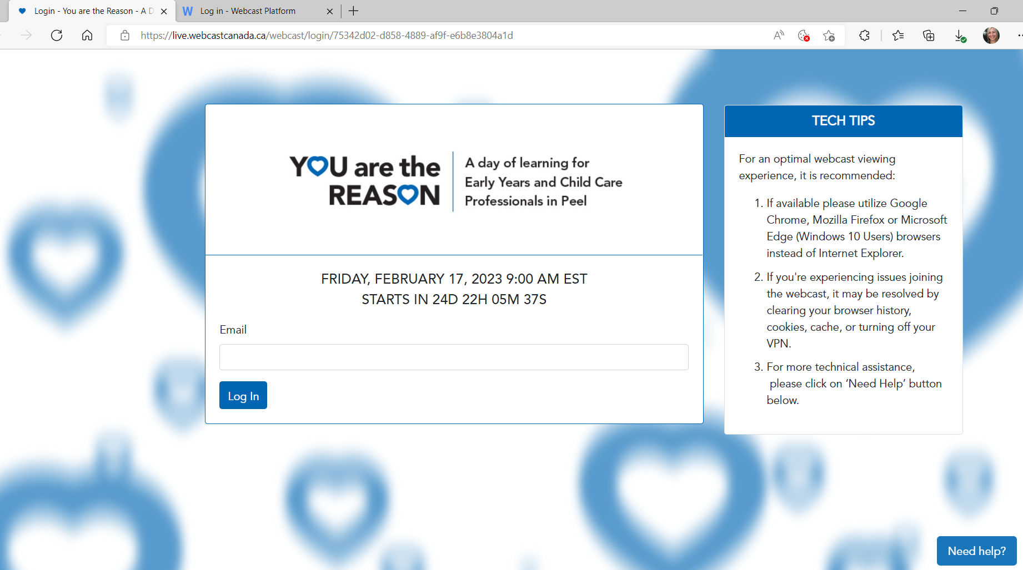
Log-in to Event Site
Link from confirmation email
Email that you registered with
Important:
If you cannot find your confirmation email after February 13, email us!

Slide 15
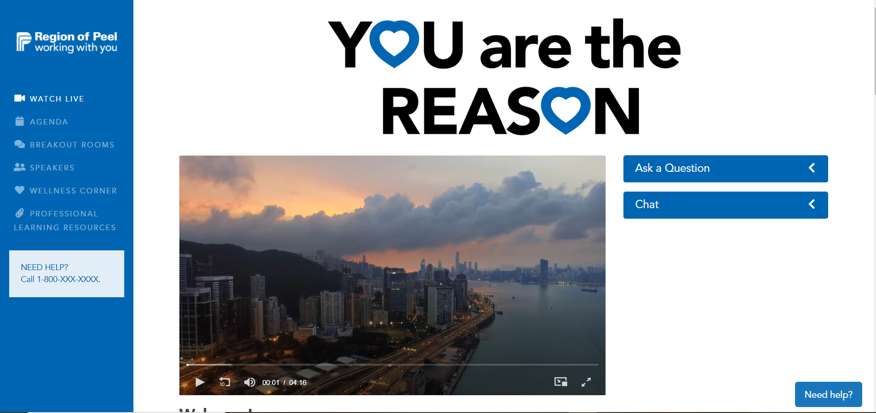
Event Site
Links to pages with more information
You can access your breakout session by either selecting Breakout Rooms from this menu bar or from a link provided on the Agenda page.
Questions submitted are only seen by the event staff and speakers
Post/see
Comments in the chat from all event participants.
Main Activity

Slide 16
Important
Register emails for all individuals who would like access to the event site before, during and/or after the event.
Store confirmation emails where they can be easily accessed on February 17
Breakout sessions – choice #1 is where you go unless you hear otherwise from us.
IT & Connecting (review TIP sheet prior to event):
You need Zoom on each device you are using the day of the conference.
IT help will be available the day of the event.
Encourage staff to complete post-event survey for the day – we need your feedback!
Notes:
Reminder:
If you haven’t already done so, we kindly ask for 10 minutes of your time to complete the Mentoring Program Survey. We have extended the deadline to January 31, 2023. An invitation to complete this survey was sent to you on January 5, 2023.
Your input is valuable as we develop with the support of our consultant, Jennifer Kirkham with Mischievous Cat Productions. Mentoring Programs/Onboarding Toolkits for our sector, as a resource for recruitment and retention of the EYCC workforce.
Copy and paste the following into the chat:
https://www.surveymonkey.com/r/Mentoring_LicensedHomeChildCareAgencies

Slide 17
Questions?

Slide 18
Have more questions?
Please email us at earlyyearssystemdivision@peelregion.ca or contact your Early Years Specialist.

Slide 19
Thank You!
Notes:
Thank you all for taking the time to attend today’s session. We hope that this information regarding the Region’s 2023 WIF has been helpful.

Slide 20
Appendix A: Examples - Offsetting child care fees for professional learning day
Agency Participating in CWELCC | HCC provider attends event | Age Group | Daily fee | CWELCC covers | WIF covers | Parent payment for Feb. 17
Yes | Yes | Infant (enrolled M-F) | $100 | $52.75 | $47.25 | $0
Yes | No | Infant (enrolled M-F) | $100 | $52.75 | $0 | $47.25
Yes | Yes | Infant (PT Monday and Tuesday only) | $110 | N/A | N/A | N/A
Yes | Yes | Infant (PT Thursday and Friday) | $110 | $58 | $52 (PL day is a Friday) | $0
Yes | Yes | School age child not eligible for CWELCC enrolled to attend full day on PL days | $60 (PL day) | N/A | $60 | $0
No | Yes | Preschool | $50 | N/A | $50 | $0
For example: if your infant fee is $100: CWELCC pays $52.75 and you may use WIF to cover the remaining $47.25 that the parent would have paid.

Slide 21
Appendix B: Visual – Detailed Registration Steps
Review the agenda and breakout sessions with your staff
Take a picture of your team and save to your computer
(Optional)
Review Registration Memo with Attachments
Decide how you will participate, what breakout session(s) you will attend, and if registering individually or as a group.
Each registered email will receive a confirmation email on February 13 with a link to the event site
Click on Survey Monkey Registration Form, complete fields and attach files from Steps 4 and 5, as applicable
For Group Registration Only*:
Fill out the form provided and save to your computer
Click submit on Survey Monkey Registration Form
*Group Registration – choose this option if you would like to register home visitors and home child care providers on your behalf or if home visitors and home child care providers do not have or wish to provide their email

